Slide 1
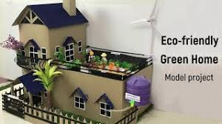
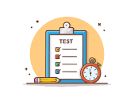
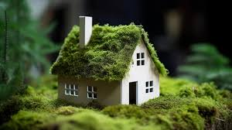
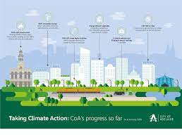
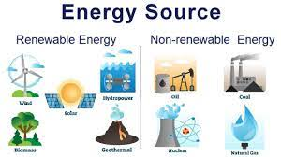
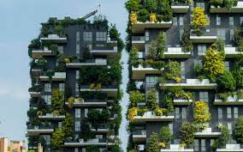
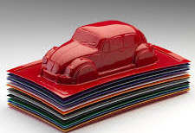
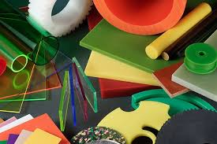
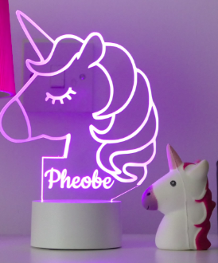
TECHNOLOGY : DESIGN TECHNOLOGY
YEAR 9 LEARNING JOURNEY
End of Year Exam
Practical Skills:
Making the model and adjusting if necessary
End of unit test
Homework:
Collecting items for modelling
YEAR
Mad time session to improve assessed work
10
Topic 2: Sustainability / Sustainable Houses
Evaluation:
Evaluation of the finished house design
Practical Skills:
Making the model and adjusting if necessary
Applying Knowledge / Creativity:
Creating designs for sustainable homes
Applying Knowledge / Design skills
Presenting final idea for a sustainable home
Knowledge:
Energy - renewable and non-renewable sources
Knowledge:
Sustainable cities - are they better and why?
Topic 2: Sustainability / Sustainable Houses
Knowledge:
How can we be more sustainable with our waste?
Homework:
From the takeaway menu - choose a task to complete
Understand:
An introduction to sustainability and sustainable lifestyles
Homework:
From the takeaway menu - choose a task to complete
In Year 9 you will enhance your practical skills and work on creating models for pieces of work. You will also apply your work to designers and work with different properties of materials. You will use new tools and equipment and design your own products
Topic 2
End of unit test
Practical Skills:
Assembling the night light
Mad time session to improve assessed work
Homework:
Understanding circuit diagrams
Lead charity fundraising
Topic 1: Nightlight
Lesson 8-9 - making the model and making adjustments if necessary
Practical Skills:
Soldering components onto circuit board
Practical Skills:
Filing base to smooth edges, drilling holes to hold base, adding picture holder
Practical Skills:
Soldering components onto circuit board
Knowledge:
How is the base of the night light formed?
Knowledge:
How a circuit is built
Topic 1: Nightlight
Homework:
Complete final design
Research:
How the process of vacuum forming works
Knowledge & Understanding:
Properties and uses of different plastics
Homework:
Plastic is not fantastic
Recap & Retrieval:
What is CAD / CAM and how is it used in this project
Creativity:
Apply research to create design ideas for
night light picture
Homework: Research on night lights
Understand:
Analysis of the design need
Year 7
Year 9
Topic 1: Nightlight
Apply Design Skills:
Create final design for night light picture
Evaluation:
Evaluation of design ideas to refine ideas for final design
Recap & Retrieval:
Writing a specification for night light – Link to years 7 & 8
Understand:
Introduction to night light project
Assessment
Curriculum content
Homework

