Slide 1
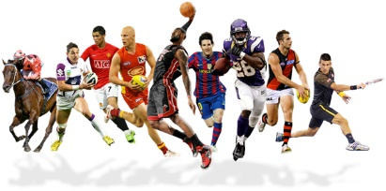
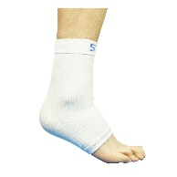
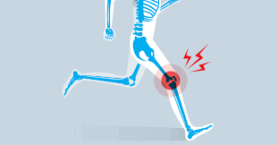
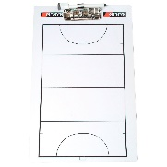
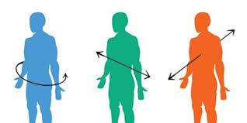
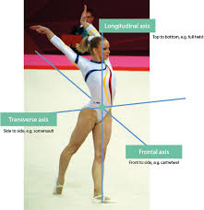
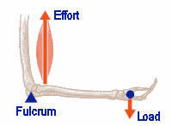
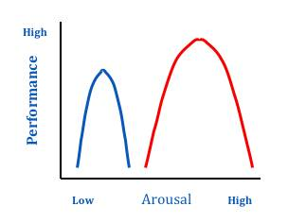
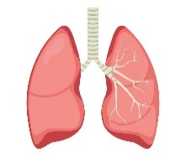
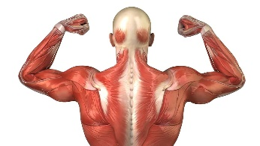
Pleckgate High School
GCSE Physical Education - OCR
Careers in Sport
Teaching
Sports scientist
Physiotherapist
Sports coach
Sports development officer
Personal trainer
Sports psychologist
Sports analyst
Sports journalist
Sports masseuse
COMPONENTS | DETAIL | ASSESSMENT
Paper 1 Section 1 – Applied Anatomy and Physiology Section 2 – Physical Training | Structure and function of the Skeletal System Structure and function of the muscular system Movement analysis The cardio – vascular system The respiratory system The effects of exercise on the body system Components of fitness Applying the principles of training Preventing injury in physical activity and training | 1 hour exam – 60 marks
Coursework - AEP | Evaluate Analyse Overview Assessment Movement Analysis Action plan | 20 marks 10%
END
OF YEAR
10
Preventing Injury
PPE
Risk Assessment
Beginning Coursework – AEP
Introduction.
Overview
Evaluation
Physical Training
TEAM SPORTS
Football
Badminton
Basketball
Hurling
Cricket
Dance
Gaelic Football
Handball
Hockey
Lacrosse
Netball
Rowing
Rugby
Squash
TT
Tennis
Volleyball
Blind Cricket
Goal ball
Powerchair Football
Table Cricket
Wheelchair basketball
Wheelchair Rugby
Fitness tests
Methods of Training
Principles of
training
Warm – up / cool down
Components of fitness
Planes of
movement
Axes of movement
Movement Analysis
Lever System
1st , 2nd 3rd – Mechanical advantage
Effects of exercise
Long and short term effects
Practical Sport
Cardio-respiratory system
Structure / Function / Location / Classification
Mechanisms / Composition / Characteristics
Anaerobic and
aerobic exercise
INDIVIDUAL SPORTS
Boxing
Athletics
Canoeing
Cycling
Diving
Gold
Gymnastics
Equestrian
Kayaking
Rock climbing
Sculling
Skiing
Snowboarding
Trampolining
Boccia
Polybat
Anatomy and Physiology
Musculo-skeletal system
Structure / Function / Location / Types / Fibres / Classification / Movement / Tissue / Characteristics
SKILLS MARKED OUT OF 20
START
OF YEAR
PRACTICAL PERFORMANCE
3 Practical activities comprising on 1 team sport, 1 individual activity and 1 of either option.
10
Paper 1

Slide 2
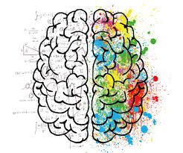
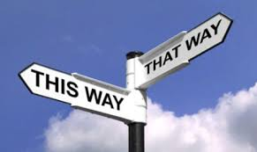
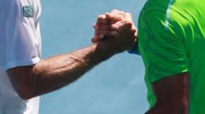
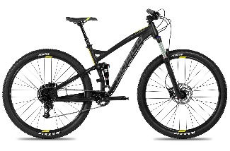
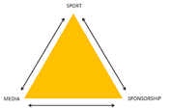
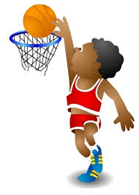
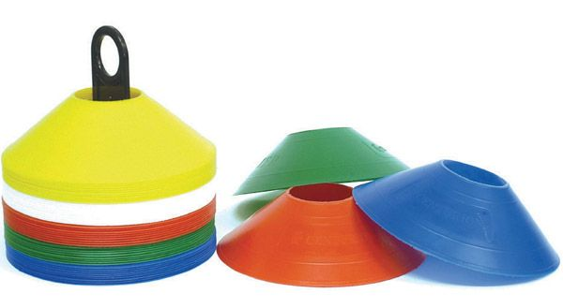
Pleckgate High School
GCSE Physical Education-OCR
Careers in Sport
Teaching
Sports scientist
Physiotherapist
Sports coach
Sports development officer
Personal trainer
Sports psychologist
Sports analyst
Sports journalist
Sports masseuse
COMPONENTS | DETAIL | ASSESSMENT
Paper 2 – Socio – cultural Influences Sports Psychology Health, Fitness and well being | Engagement patterns of different groups and activities Commercialisation of PA and sport Ethical and socio – cultural issues in PA and Sport Characteristics of a skilful movement and classification of skills Goal setting Mental Preparation Types of Guidance and Feedback Health, Fitness and well being Diet and Nutrition | 1 hour – 60 Marks – 30 %
Exams
Paper 1 / Paper 2
END
OF YEAR
11
Diet and nutrition
Balanced diet
Revision
Coursework
moderation
Fitness
Specific diets for athletes
Practical
moderations
Socio-Cultural Influences
ASSESSMENTS
TEAM SPORTS
Football
Badminton
Basketball
Hurling
Cricket
Dance
Gaelic Football
Handball
Hockey
Lacrosse
Netball
Rowing
Rugby
Squash
TT
Tennis
Volleyball
Blind Cricket
Goal ball
Powerchair Football
Table Cricket
Wheelchair basketball
Wheelchair Rugby
Wellbeing- social/ emotional
SMART
targets
COMPETITIVE SITUATION MARKED OUT OF 25
Feedback
Mental preparation
Sports Psychology
Guidance
Goal Setting
SMART
Classification of skills
Practical Sport
Engagement patters/ trends
Ethics sportsmanship, gamesmanship
Characteristics of a skilful movement
INDIVIDUAL SPORTS
Boxing
Athletics
Canoeing
Cycling
Diving
Gold
Gymnastics
Equestrian
Kayaking
Rock climbing
Sculling
Skiing
Snowboarding
Trampolining
Boccia
Polybat
Ice skating
Sailing
Socio – cultural wellbeing
SKILLS MARKED OUT OF 20
Media coverage
Commercialisation
Paper 2 -
Retrieval paper 1 – throughout Year
START
OF YEAR
11
Analysis and evaluation of performance
Completion of AEP
PRACTICAL PERFORMANCE
3 Practical activities comprising on 1 team sport, 1 individual activity and 1 of either option.

