Slide 1
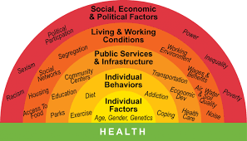
Design
deas
HEALTH AND SOCIAL CARE AT PLECKGATE
YEAR 10 LEARNING JOURNEY
End of Year Exam
Resource Barriers
Geographical Barrier
Language Barriers
YEAR
Mad time session to improve assessed work
11
Social and Cultural
Topic A3 Barriers to services
Sensory barriers
Physical Barriers
Social Care
MAD TIME ON THE ASSESSMENT
Health services
Topic A2 Social Care Services
Topic A1 Healthcare Services
Component 2; Health and Social Care Values
Health conditions
Additional Care
PSA task released and completion of the 4 tasks for component 1
types of support to adapt to change
How people cope with change
Start of the PSA from Jan - May
Topic B1 Life Events
Life Circumstances
Lead charity fundraising
Topic B2 Change
Specification
MAD TIME ON THE ASSESSMENT
Sources of support offered for change
Relationship Changes
Health and Wellbeing
Topic B1 Life Events
Assessment of Factors through G&D
Lifestyle Factors
Emotional Factors
Environment Factors
MAD TIME ON THE ASSESSMENT
Topic A2 Factors
Physical Factors
Social Factors
Cultural Factors
Economic Factors
Assessment of two life stages on the G&D characteristics
Later Adulthood PIES Growth and Development
Assessment of two life stages growth and development
Homework: the questions and notes
Year 7
Year 9
Middle Adulthood PIES Growth and Development
Component 1: Human Lifespan and Development
Early Adulthood PIES Growth and Development
Adolescence PIES Growth and Development
Early Childhood PIES Growth and Development
Infancy PIES Growth and Development
Assessment
Curriculum content
Homework

