Slide 1
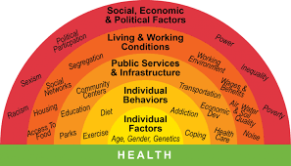
HEALTH AND SOCIAL CARE AT PLECKGATE
YEAR 11 LEARNING JOURNEY
End of Year Exam
Resource Barriers
Geographical Barrier
Language Barriers
YEAR
Mad time session to improve assessed work
12
Social and Cultural
Topic A3 Barriers to services
Sensory barriers
Physical Barriers
Informal Support
Assessment of support through G&D
Health services
Component 3
Support
Recommendations of support
Additional Care
Formal Support
Circumstances of the individual
Wishes of the individual
Assessment of indicators through G&D
MAD TIME ON THE ASSESSMENT
Person Centered Approach
MAD Time of Indicators through G&D
Lifestyle Indicators
Lead charity fundraising
Assessment of indicators through G&D
Needs of the individual
Health Indicators
Physiological Indicators
Assessment of Factors through G&D
Lifestyle Factors
Emotional Factors
Environment Factors
Factors affecting health
Component 3
MAD TIME ON THE ASSESSMENT
Physical Factors
Social Factors
Cultural Factors
Economic Factors
Weeks 5-6 Completion of PSA5
Weeks 4-5 Completion of PSA 4
Weeks 3-4 Completion of PSA 3
Year 7
Year 10
PSA Tasks for Component 2
Weeks 2-3– Completion of PSA 2 Services
Weeks 1-2 – Completion of PSA1 Primary and Secondary Service
Assessment
Curriculum content
Homework

