Slide 1
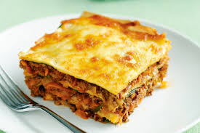
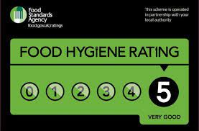
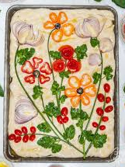
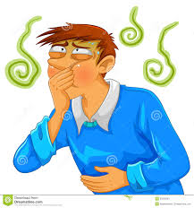
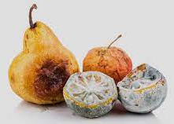
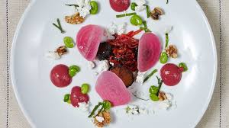
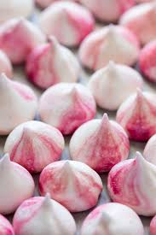
WJEC LEVEL 1 / 2 HOSPITALITY & CATERING AT PLECKGATE - YEAR 10 LEARNING JOURNEY
2.4.1 Reviewing dishes throughout the course:
Pupils will review the dishes made by looking at:
Dish production Dish selection Health and safety Hygiene Improvements Organoleptic Presentation Waste
2.2.1 Be aware:
Of nutritional advice, cost, portion control, time of day, customers
2.2.1 Be aware:
Of environmental issues
2.2.1 Be aware:
Of the factors affecting menu planning
MOCK
Exam questions and techniques
YEAR
11
2.2 – Menu Planning
EXAM
1.2.1 Gain knowledge of:
Large and small equipment used in Hospitality and Catering
ASSESSMENT written exam and practical work on mock NEA
REVIEW of written exam
2.4.1 Be able to:
Review dishes
MOCK written exam
Revision
2.3.1 Demonstrate:
a range of different level skills in practical dishes
2 hour Mock NEA practical
Revision sessions / lessons on work covered in Unit 1
1.1.3 Investigate:
Working conditions of different job roles across the hospitality and catering industry
1.2.2 Investigate:
How the industry meets customer needs
1.2.2 Investigate:
How the industry adapts to meet customer needs
Practical Lesson
Lemon meringue pie
2.3.3 Demonstrate:
Safe food practices
1.1.2 Job requirements within the hospitality and catering industry
1.2 – How Hospitality & Catering Provisions Operate
1.1.2 – Working in Hospitality & Catering Industry
2.3.2.Consider:
Presentation techniques
1.1.2 Understand:
What personal attributes,
Qualifications and experience employers look for
1.1.3 Be aware of:
Remuneration and benefits
Practical Lesson
Choux pastry – profiteroles or eclairs
Research, plan and cook a meal for a specific provision
Cooking terms:
Pupils will build a glossary of terms and their meanings over the year
1.1.2 Understand:
Job roles within the hospitality and catering industry
Practical Lesson
Lasagne – meat and white sauce
1.1.1 Understand:
The difference between commercial and non commercial providers and residential and non residential
1.1.1 Understand:
Non-Commercial residential providers e.g. armed forces, prisons
1.1.1 Understand:
Commercial non-residential providers e.g. takeaways, airlines, cafes
Practical Lesson
Pineapple upside down cake and custard
1.1.1 Gain knowledge:
of the two different types of catering provision
1.1.1 Understand:
The importance of standards and ratings
1.1.1 Assessment:
Researching hospitality and catering providers in our area
1.1.1 – Hospitality & Catering Providers
Practical Lesson
Swiss roll
1.1.1 Gain knowledge:
Styles of service provided by hospitality and catering providers
1.1.1 Understand:
Non-Commercial non-residential providers e.g. schools
1.1.1 Understand:
Commercial residential providers e.g. hotels, B&B, campsites
1.1.2 Understand:
Employment roles and responsibilities
1.4.4 Understand:
The role and responsibilities of an EHO
1.4. End of Unit Assessment
1.4.1 Know and understand:
Food labelling laws
Food safety legislation
Assessment:
How cooking impacts nutritional
value of food
2.2.2 Understand:
Production plans and factors that need including
1.4.1 Understand:
Contamination of food – physical and chemical
1.4.3 Understand and know how to apply:
Preventative control measures HACCP
2.1.2 Be aware of:
How cooking methods impact on nutritional value of foods
1.4.1 / 2.1.1 Know and understand:
Food allergies
Practical Assessment
Following production plan to cook meal
2.1 – Cooking methods impact on nutritional value
1.4 – Food related causes of ill health
Practical Lesson
Mayonnaise and meringues
1.4.1 / 2.1.1 Know and understand:
Food intolerance
1.4.1 Explain:
Spoilage of food
1.1.3 Understand:
The importance of appropriate presentation of dishes
Practical Lesson
Bread – Decorated foccacia
1.4.1 – Gain knowledge:
Of the types of food poisoning bacteria
Demonstrate:
Correct personal and food hygiene and safety when preparing and cooking food
Practical Lesson
Presentation Techniques – Tunnocks teacake challenge
Assessment:
LST – Allergies
& Intolerances
1.4.2 Understand:
The visible and invisible symptoms of food induced ill health
1.4.1 / 2.1.1 Know and understand:
Characteristics of unsatisfactory nutrition
2.1.1 Apply knowledge:
to nutritional needs of different life stages
2..1.1 Gain knowledge:
Of the micronutrients – vitamins and minerals
2..1.1 Gain knowledge:
Of the macronutrients – fats, proteins and carbohydrates
2.2.1 – Factors affecting menu planning
Practical Lesson
– Enriched bread dough – Chelsea buns
Baseline Assessment
Assessment:
Test on Nutrients
YEAR
2.1.1 Know and understand:
Balanced diets / current nutritional advice
2.1.1 – The Importance of Nutrition
10
Practical Lesson
Cook a main course dish for specific dietary requirement
Apply knowledge:
Research and plan a meal for a specific dietary requirement
2.1.1 Investigate:
Special dietary needs for individuals with different dietary requirements
2.1.1 Gain knowledge:
Of function of water and fibre
Practical Lesson
Knife skills - carrot & coriander soup
2..1.1 Understand:
The functions and sources of different nutrients
Introduction to a new specification:
The course structure and units
Practical work
Unit 1 - The hospitality and catering industry – Written examination 1 hour 20 minutes – 80 marks – 40% of qualification
Unit 2 - Hospitality and catering in action – Controlled assessment approximately 12 hours - 60% of qualification
AO1 - Demonstrate knowledge and understanding from across the specification.
AO2 - Apply skills (including practical skills), knowledge and understanding in a variety of contexts, in planning and carrying out investigations and tasks.
AO3 - Analyse and evaluate information, making reasoned judgements and presenting conclusions.

