Slide 1


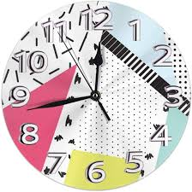
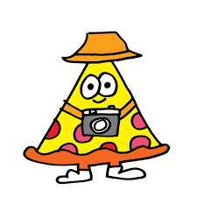




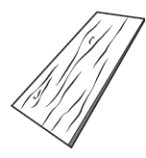


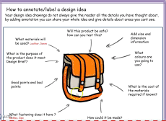
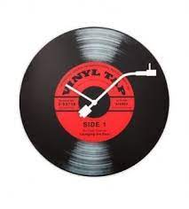
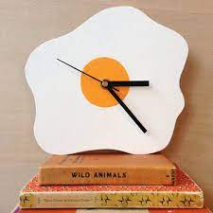
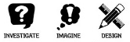


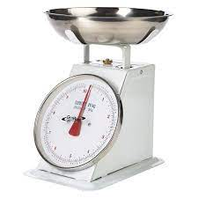
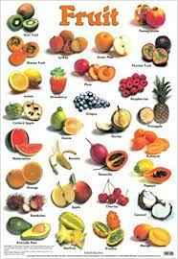
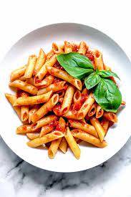
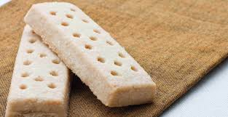

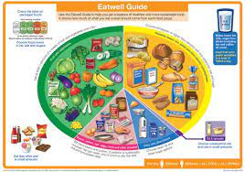

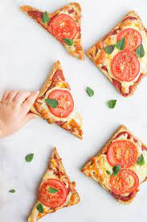



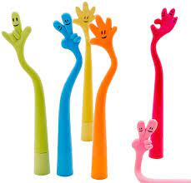
Design
ideas
TECHNOLOGY WITH CATERING AT PLECKGATE
YEAR 7 LEARNING JOURNEY
Product Evaluation
Final product and testing against the specification
End of Year Exam
YEAR
Mad time session to improve assessed work
8
MAKING A CLOCK - TECHNOLOGY PROJECT
Applying the finish and sanding
Drilling
Making a template
Marking out of final idea
Cutting
Final Design Ideas
Annotations of design ideas
MAKING A CLOCK - TECHNOLOGY PROJECT
Paper and card properties
Moodboard
Lesson 3&4 Task analysis & Research designers
Lead charity fundraising
Topic 3
Mad time session to improve assessed work
Homework: bring ingredients for practical
Clock Project
Specification
Lesson 5 - ACCESS FM analyse existing products
Lesson 1 & 2 Design process & Design brief
Lesson 7 – carrot cake practical
Lesson 6 the creaming method
Lesson 7 - the rubbing in method
Lesson 8 - shortbread biscuits
Lesson 5 – making a pasta dish?
Lesson 5 – Pizza toast practical
Lesson 2: fruit practical?
Lesson 3 – assessment piece of a menu?
Mad time session to improve assessed work
Topic 2
Healthy Eating
Assessment of practical for pizza toast
Lesson 1: what is the Eatwell Guide?
Homework: bring ingredients for practical
Lesson 4 – the importance of nutrients
Assessment of planning for pizza toast
Homework: ingredients for pizza toast
Homework: complete the hygiene work
Assessment of the final pen design based on the ideas
Year 7
Pen Baseline Assessment
Year 7
Lesson 4 – How do I plan for pizza toast?
Topic 1: An introduction to Catering
Lesson 3 - can I identify parts of the cooker?
Lesson 2 - hot chocolate and toast
Lesson 1: Why is hygiene important? Looking at personal and cooking hygiene
6 week assessment on creating and making a pen
K
Assessment
Curriculum content
Homework

