Slide 1
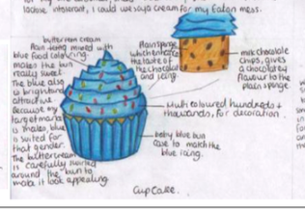
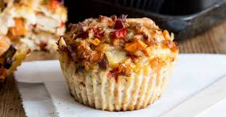
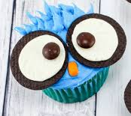
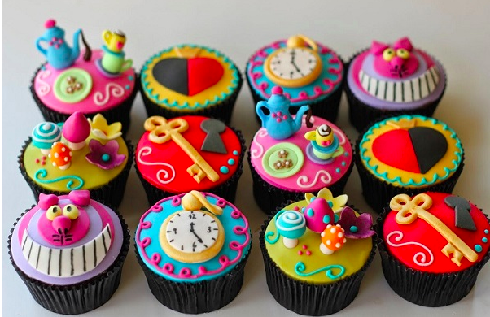
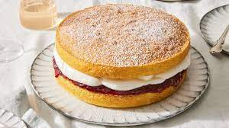
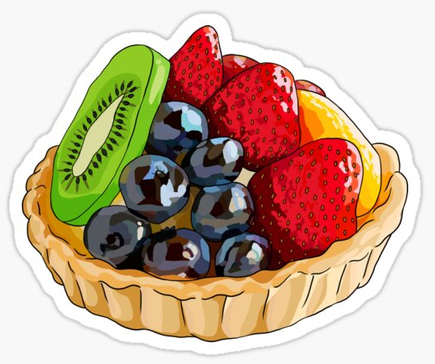
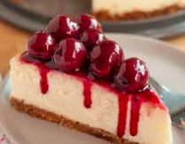
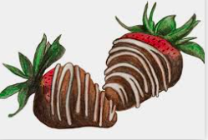
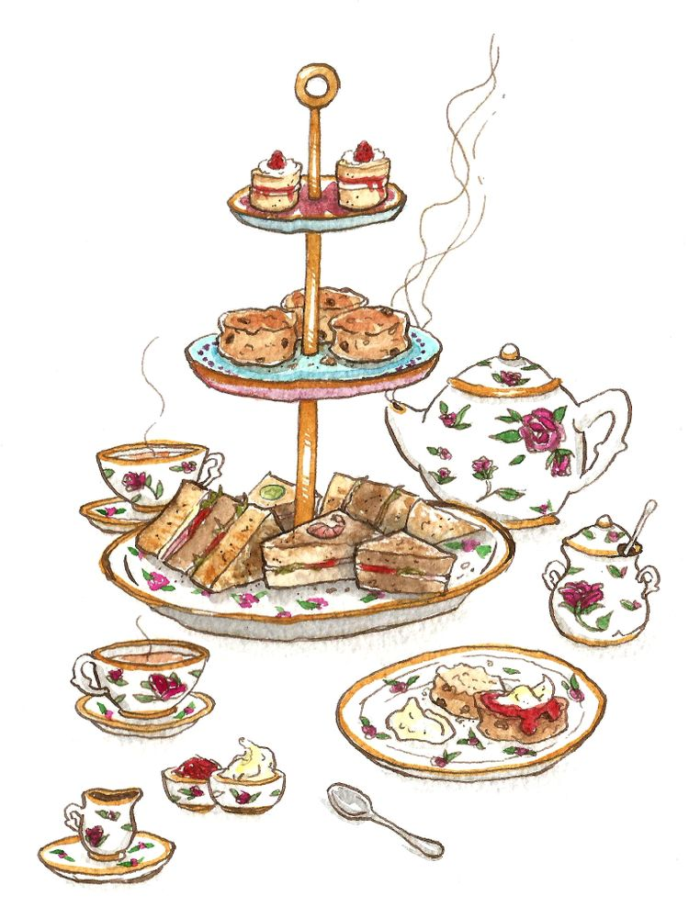
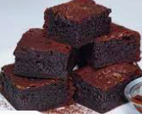
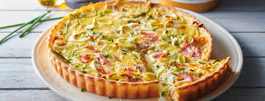
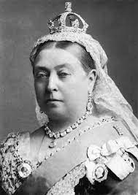
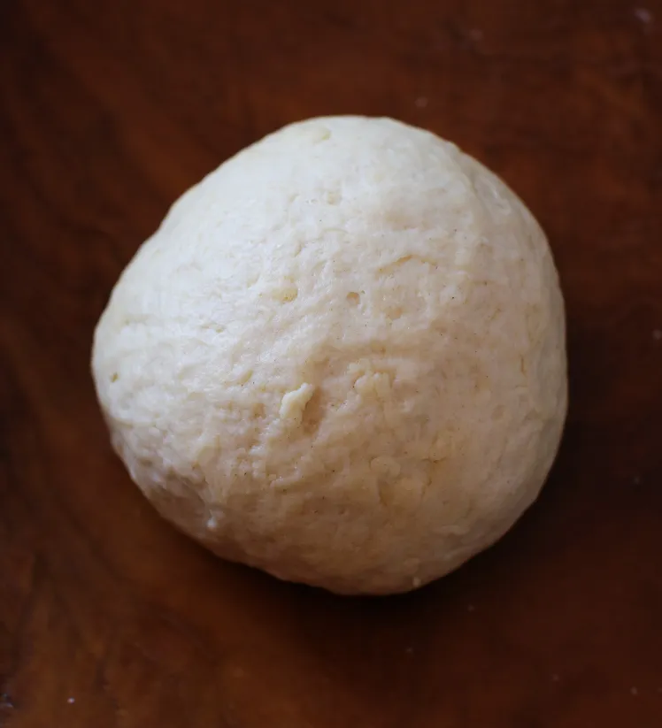
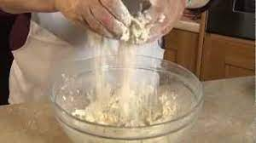
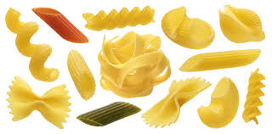
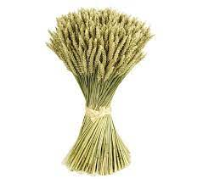
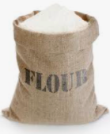
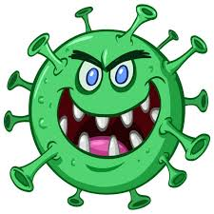
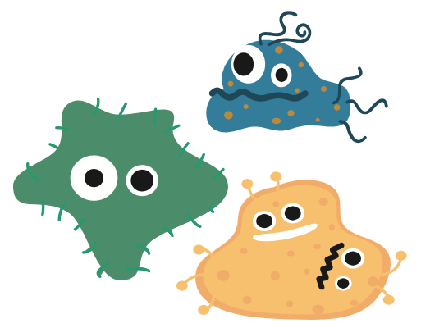
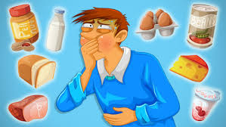
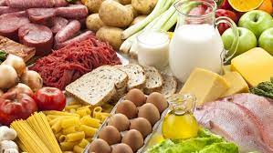
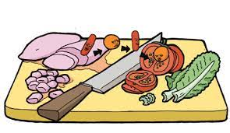
`
CATERING AT PLECKGATE
YEAR 8 CURRICULUM MAP
Demonstrate Skills and Techniques:
Savoury Muffins practical
Choosing ingredients, making a batter mixture, portioning control and using oven
Become Star chef
of the practical
End of Year Exam
Peer Assessment:
of menu
Understand:
How to correctly annotate designs
Use:
Art and design skills
to produce diagrams of cupcake ideas
YEAR
Mad time session to improve assessed work
Decorated cupcakes Practical
Understand:
How to successfully complete a design brief
9
Chef
awards
Savoury Muffin Practical
Make: Improvements to menu
Demonstrate Skills and Techniques:
Decorated cupcakes practical
Opportunity to be creative and choose own ingredients.
Put their design idea into practice.
Understand:
How to successful annotate design ideas
Demonstrate Skills and Techniques:
Savoury whirls practical
Shaping, knife skills, glazing & sealing
Become Star chef
of the practical
Design Brief:
Can you design a cupcake suitable for Afternoon Tea?
Discussion:
On convenience foods and their place in cooking
Understand:
What sweet foods are
Investigate:
What elements make a good menu?
Discover:
Which British monarch had a cake named after them
Become Star chef
of the practical
Cheesecake Practical
Savoury whirls Practical
Afternoon Tea
Knowledge:
Who started afternoon tea?
Demonstrate Skills and Techniques:
Cheesecake practical
Forming a base, whisking, folding, decorating
Assessed practical
Become Star chef
of the practical
Understand:
What savoury foods are
Apply:
knowledge to produce a menu for Afternoon Tea
Assessed work
Consider:
Presentation of dishes and decoration of food
Decision making:
Pupils to choose how to decorate their cheesecake
Food Science:
How does puff pastry rise?
Demonstrate Skills and Techniques:
Brownies practical
Melting chocolate, whisking, folding, baking
Afternoon Tea
What is afternoon tea and what foods could be included?
Can you plan a suitable afternoon tea?
Knowledge:
When did afternoon teas first start?
Understand:
How to make shortcrust pastry using rubbing-in-process
Assessed work
Demonstrate Skills and Techniques:
Shortcrust pastry practical
Using rubbing-in technique
Become Star chef
of the practical
Quiche Practical
Link to Year 7:
Rubbing in method (Scones)
Mad time session to improve assessed work
Chocolate Brownies Practical
Shortcrust pastry Practical
Chef
awards
Become Star chef
of the practical
Food Science:
What is coagulation?
Demonstrate Skills and Techniques:
Quiche practical
Rolling out pastry, lining a tin, knife skills, frying vegetables – use of hob
Assessed practical
Produce:
A report on different types of pasta
Investigate:
How is wheat milled into flour?
Describe:
The milling process
Demonstrate Skills and Techniques:
Pizza practical
Kneading, shaping, knife skills
Knowledge:
How is pasta manufactured?
Investigate:
What ingredients can be used to fill pasta
Recap and retrieval:
organisation / routine in practical lessons
Flour & Flour products
Pizza Practical
Flour & Flour products
Project 1 - Flour & Flour Products
How does wheat become flour?
What products can it be used to make?
Food Science:
What is gluten?
Understand:
Which parts of the grain are used for different flours
Understand:
What primary processing is?
Understand:
What secondary processing is?
Become Star chef
of the practical
Recap and retrieval:
Personal hygiene
Food Science:
How gluten is formed
Apply:
knowledge to produce powerpoint or booklet explaining food hygiene to Y7 pupils
Assessed work
Investigate:
What causes food poisoning
Recap and retrieval:
of food hygiene and safety in the kitchen
Link to Year 7:
Calamity Kitchen
In Year 8 learners will develop confidence in cooking a range of savoury and some sweet dishes. Build on skills from Year 7. This will be taught alongside theory lessons
Knowledge:
What effect do microorganisms and enzymes have on food?
Knowledge:
What is bacteria?
Understand:
Which groups of people are high risk?
3.4
End of Year 7 Assessment
Bacteria & Food Poisoning
How do we prevent bacteria cross-contaminating food?
YEAR
Knowledge:
Which foods are high risk and why are they high risk?
Food Poisoning
Food Hygiene
8
Knowledge:
How do we prevent bacteria from growing?
Understand:
What is the danger zone?
Apply Knowledge:
To answer questions on cross-contamination
Understand:
How to prevent cross-contamination
Knowledge:
What conditions does bacteria need to grow?
Link to Year 7:
Calamity Kitchen
Culinary skills
These are carried out throughout the course and are built upon and extended during year 8
What are the critical food temperatures?
YEAR 8:
TO BUILD ON AND EXTEND PRACTICAL SKILLS LEARNT IN YEAR 7
Theory
Assessed Work / Exam
Food Science
Practical
Assessed
Practical

