Slide 1
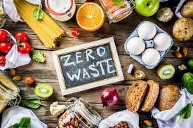
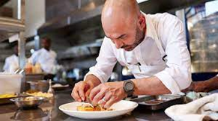
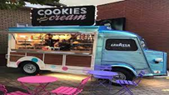
DESIGN TECHNOLOGY: CATERING AT PLECKGATE
YEAR 9 LEARNING JOURNEY
Lesson 10: Practical on food waste
Lesson 9 food waste
Lesson 8 assessment of practical
End of Year Exam
Homework: bring ingredients
YEAR
Mad time session to improve assessed work
10
Topic 2: Job Roles within Catering
Lesson 7: famous TV chef
Lesson 6 – food miles and the impact of food miles
Lesson 5: Maid of Honour
Lesson 3: the role of the pastry chef
Lesson 4: assessment lesson what is the role of the pastry chef?
Topic 2: Job Roles within Catering
Lesson 1: the kitchen brigade and the roles within the kitchen
Lesson 2: practical on fajitas?
Homework: bring ingredients
Topic 2
Lesson 10 - Dippers
Homework: bring ingredients for practical
Mad time session to improve assessed work
Lead charity fundraising
Topic 1 - Street Foods
HW: Ingredients for the practical
Lesson 9 - The role of the Head Chef
Lesson 8 - Chicken Practical Assessment
Lesson 7 - Menu Planning
Lesson 3&4: Takeaway Menu
Lesson 6: Pasta Practical Lesson
Lesson 4: Street Food van assessment piece
Lesson 5 –can I create packaging for a street food item?
HW Lesson 5 -Ingredients for the practical
Lesson 2 HW: Takeaway Menu
Lesson 1 HW: Ingredients and Takeaway Menu Piece
Year 7
Year 9
Topic 1: Street Foods?
Lesson 3 – Assessment piece of street foods
Lesson 2: kebabs practical
Lesson 1: What are street foods?
Assessment
Curriculum content
Homework

