Slide 2
Phase 1
Phase 2
Phase 3
Information about the process
Research and Guidance
Decision Making

Slide 3
Details of Process and Decisions to be made
Options information for pupils 23rd January 2025:
Options briefing
Blackburn College Futures talks
Options presentations by subject leaders
Parent Briefing 23rd January 2025, 5.00pm

Slide 4
Research, Evidence and Consideration
Option booklet launched on Google Classroom and Pleckgate website Monday 27th January 2025
Year 9 Reports - uploaded to EduLink wc 27th January
Tutor group time spent researching options choices
Year 9 Parents’ Evening - Tuesday 4th February 2025

Slide 5
Delivered in Year 10 and 11 to give a broad, general knowledge across a range of subjects.

Slide 6
GCSEs, BTECs, CNATs and Vocational Awards
GCSEs - Grade 9-1, grade 5 is a ‘strong pass’
BTECs/CNATs/Voc Awards - Grades L2D*, L2D, L2M, L2P, L1D, L1M, L1P
Level 2 pass or grade 4 needed to access Level 3 qualifications (A Levels, apprenticeships, BTEC L3) at college
Level 3 qualifications required to progress to Level 4 (Higher Education, University)

Slide 7
EBACC is a suite of qualifications
Colleges, sixth forms, universities and employers use as criteria
Indication of a broad and balanced range of knowledge and skills
Qualifications in English, mathematics, science a humanities subject and a modern foreign language at grade 5 or above

Slide 8
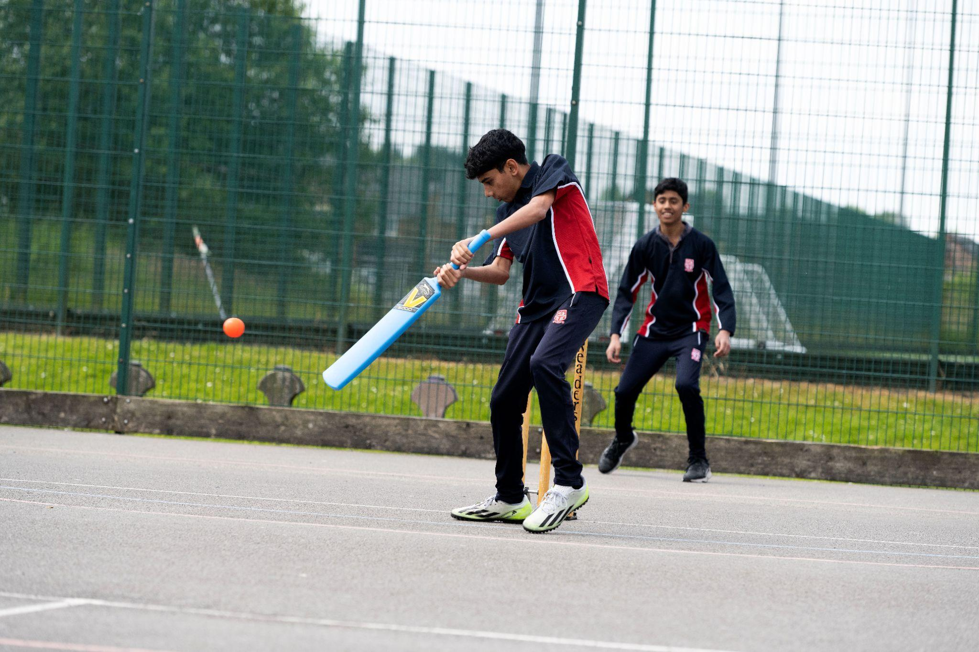
PSHE - Personal, social and health education
Core PE

Slide 9
Our Curriculum - Compulsory Qualifications
GCSE English Language
GCSE English Literature
GCSE Mathematics
GCSE Combined Science (2 GCSEs)
GCSE RE
Humanities: choice of GCSE History or GCSE Geography

Slide 10
Our Curriculum - Compulsory Qualifications
GCSE English Language
GCSE English Literature
GCSE Mathematics
GCSE Combined Science (2 GCSEs)
GCSE RE
Humanities: choice of GCSE History or GCSE Geography
Language: choice of GCSE French, GCSE Urdu or GCSE Arabic

Slide 11
Our Curriculum - Optional Qualifications
Two additional choices from the following subjects:
GCSE Art
GCSE Arabic
GCSE Business
GCSE Computer Science
GCSE Drama
GCSE Design Technology
GCSE French
BTEC Health and Social Care
Vocational Award in Hospitality and Catering
CNAT Information Technology
BTEC Music
GCSE Physical Education
CNAT Sport
GCSE in Triple/Separate Sciences (Biology, Chemistry and Physics)
GCSE Sociology
GCSE Statistics
GCSE Urdu

Slide 12
Our Curriculum - Optional Qualifications
One additional choice from the following subjects:
GCSE Art
GCSE Business
GCSE Computer Science
GCSE Drama
GCSE Design Technology
BTEC Health and Social Care
L1/2 Vocational Award in Hospitality and Catering
BTEC Information Technology
BTEC Music
GCSE Physical Education
CNAT Sport Studies
GCSE in Triple/Separate Sciences (Biology, Chemistry and Physics)
GCSE Sociology
GCSE Statistics

Slide 13
Setted subjects
Maths
Core PE
All other subjects are mixed ability to some extent.
Set information is not shared with pupils/parents, classes have subject related names to improve self esteem and ensure pupils have the right focus

Slide 14
Putting your child in the best place for their future

Slide 15
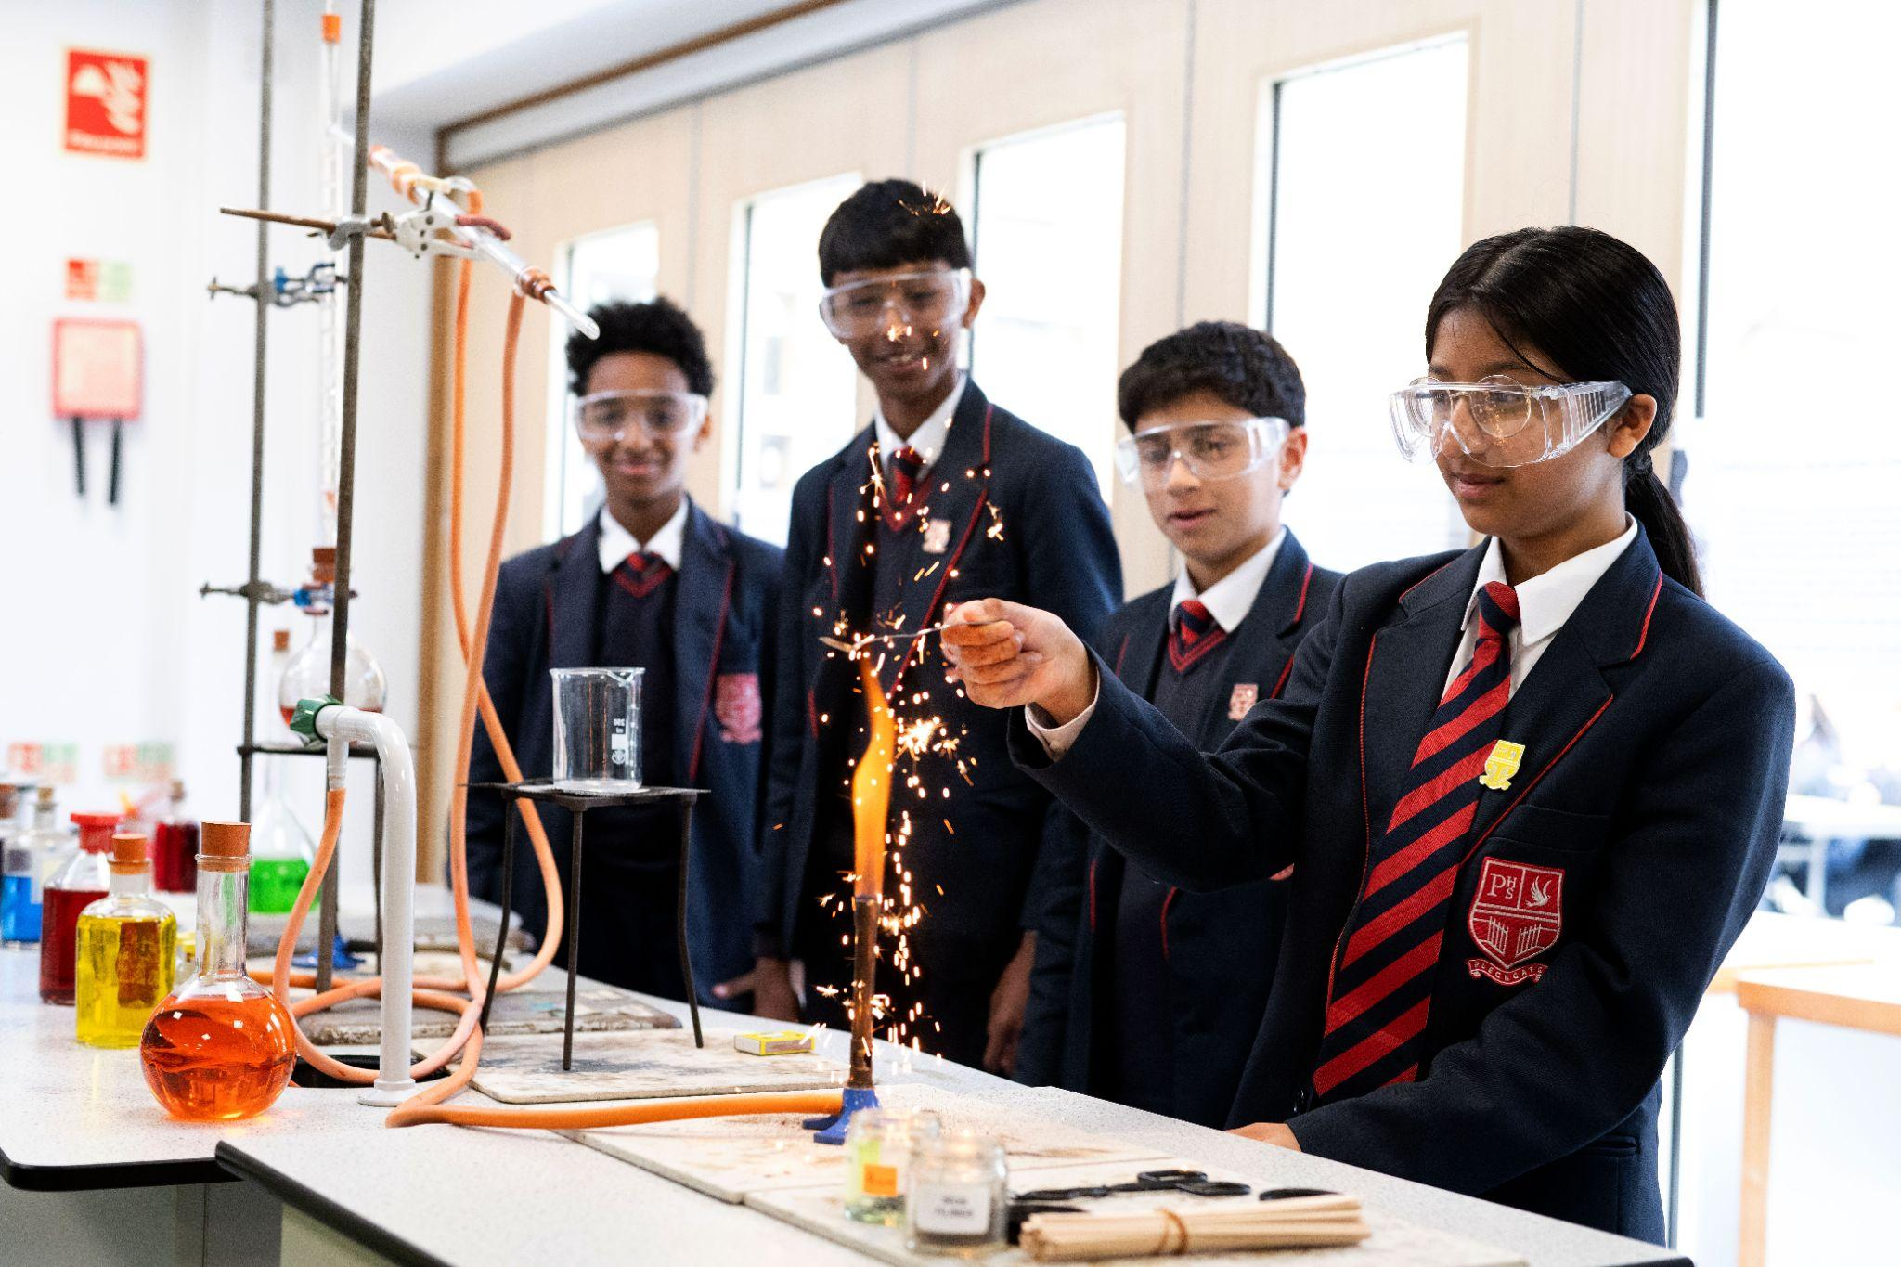
Grades are usually more important than subjects
In which subjects will your child work hardest and perform the best?
Success results from ENJOYMENT
Future study plans and career options
Research thoroughly (3 weeks)

Slide 16
Pick a subject because of somebody else’s reasons
Pick a subject because your child likes the teacher
Make assumptions without proper research

Slide 17
The options process must be followed correctly by all pupils
Option booklet launched on Google Classroom and Pleckgate website Monday 27th January 2025

Slide 18
Option choices will only be accepted on the Google form before 13th February 2025
Reserve choices must be stated when requested - these might be what are allocated
There are no guarantees that an option choice will be offered
Ask for advice from experts and listen carefully
Questions should be directed to Miss Hartley or Mr McKenzie
Opportunity for parents to attend one to one meetings with members of the Senior Leadership Team if they wish to discuss their child’s curriculum or the options process further on 27th February 2025

Slide 19
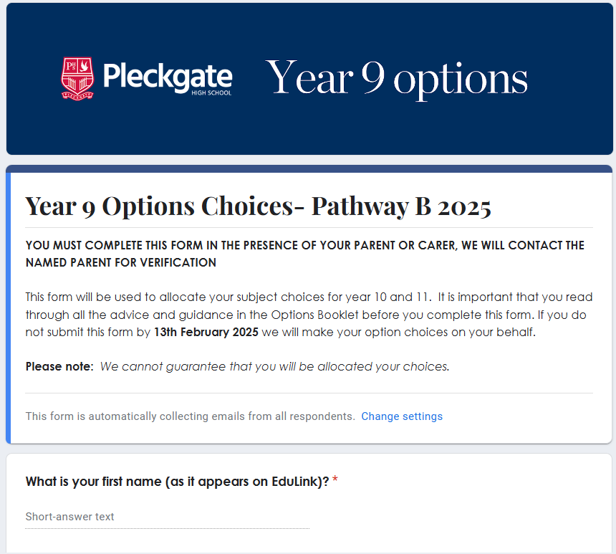
Emailed to pupils school email address
Should not be submitted until your child is absolutely certain (they will not be able to change their mind)
Must be completed in the presence of parent/carer
Contains important instructions, if the form is completed incorrectly we will make the decisions on their behalf

