Slide 1

KS4 Curriculum Options 2026

Slide 2

Options Timeline
Phase 1 - Information about the process
Phase 2 - Research and Guidance
Phase 3 - Decision Making

Slide 3


Options Phase 1: April 2026
Details of Process and Decisions to be made
Options information for pupils 15th April 2026:
Options briefing
Options presentations by subject leaders
Parent Briefing 16th April 2026, 5.00pm

Slide 4

Options Phase 2: April 2026
Research, Evidence and Consideration
Option booklet launched on Google Classroom and Pleckgate website Friday 17th April 2026
Year 9 Reports - given out at parents evening 21st April
Tutor group time spent researching on UniFrog
Year 9 Parents’ Evening - Tuesday 21st April 2026

Slide 5
Options Phase 3: May 2026
Decision Making
Google form sent out - Wednesday 22nd April 2026
Deadline for completion of Google form, 3pm 5th May 2026
Optional parents’ meeting with Senior Leadership Team, 14th May 2026
Option choices will be confirmed, in writing, in July 2026

Slide 6
Level 2 Qualifications
Delivered in Year 10 and 11 to give a broad, general knowledge across a range of subjects

Slide 7
What are Level 2 Qualifications?
GCSEs, BTECs, CNATs and Vocational Awards
GCSEs - Grade 9-1, grade 5 is a ‘strong pass’
BTECs/CNATs/Voc Awards - Grades L2D*, L2D, L2M, L2P, L1D, L1M, L1P
Level 2 pass or grade 4 needed to access Level 3 qualifications (A Levels, apprenticeships, BTEC L3) at college
Level 3 qualifications required to progress to Level 4 (Higher Education, University)

Slide 8
What is the English Baccalaureate?
EBACC is a suite of qualifications
Colleges, sixth forms, universities and employers use as selection criteria
Indication of a broad and balanced range of knowledge and skills
Qualifications in English, mathematics, science a humanities subject and a modern foreign language at grade 5 or above

Slide 9
Our Curriculum - Compulsory Qualifications
Pathway A
GCSE English Language
GCSE English Literature
GCSE Mathematics
GCSE Combined Science (2 GCSEs)
GCSE RE
Humanities: choice of GCSE History, GCSE Geography or GCSE Sociology

Slide 10
Our Curriculum - Compulsory QualificationsP=
Pathway B
GCSE English Language
GCSE English Literature
GCSE Mathematics
GCSE Combined Science (2 GCSEs)
GCSE RE
Modern foreign language: GCSE French or GCSE Urdu
Humanities: choice of GCSE History, GCSE Geography or GCSE Sociology

Slide 11
Our Curriculum - Compulsory Lessons
PSHE - Personal, social and health education
Core PE

Slide 12
Our Curriculum - Optional Qualifications
Pathway A
Two additional choices from the following subjects:
GCSE Art
GCSE Business
GCSE Computer Science or CNAT Information Technology
GCSE Drama
GCSE Design Technology
GCSE French
BTEC Health and Social Care
Vocational Award in Hospitality and Catering
CNAT Information Technology
GCSE Music or BTEC Music
GCSE Physical Education or CNAT Sport
GCSE in Triple/Separate Sciences (Biology, Chemistry and Physics)
GCSE Statistics
GCSE Urdu

Slide 13
Our Curriculum - Optional Qualifications
Pathway B
One additional choices from the following subjects:
GCSE Art
GCSE Business
GCSE Computer Science or CNAT Information Technology
GCSE Drama
GCSE Design Technology
BTEC Health and Social Care
Vocational Award in Hospitality and Catering
CNAT Information Technology
GCSE Music or BTEC Music
GCSE Physical Education or CNAT Sport
GCSE in Triple/Separate Sciences (Biology, Chemistry and Physics)
GCSE Statistics

Slide 14
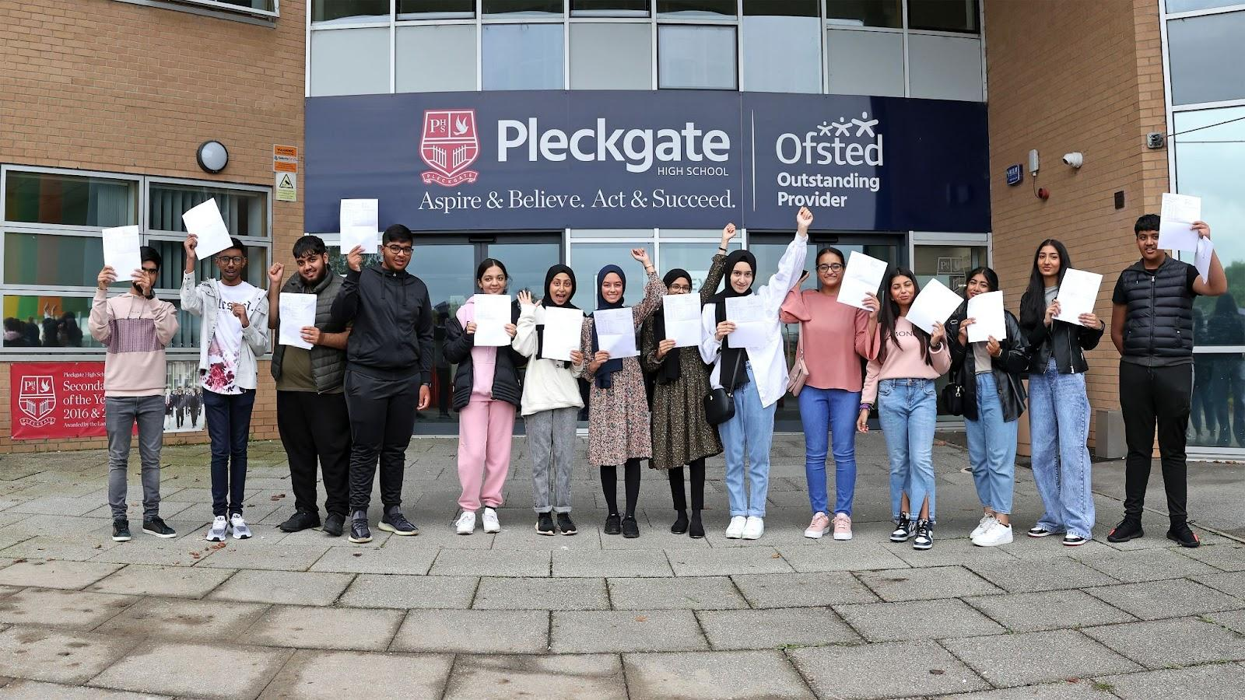
Putting pupils in the best place for their future
Decision Making

Slide 15
Things to Consider
Grades are usually more important than subjects
In which subjects will you work hardest and perform the best?
Success results from ENJOYMENT
Future study plans and career options
Research thoroughly (3 weeks)

Slide 16
DO NOT
Pick a subject because of somebody else’s reasons
Pick a subject because you like the teacher
Make assumptions without proper research

Slide 17
Important Points
The options process must be followed correctly by all pupils

Slide 18
Important Points
Option choices will only be accepted on the Google form before 5th May 2026
Reserve choices must be stated when requested - these might be what you are allocated
There are no guarantees that an option choice will be offered
Ask for advice from experts and listen carefully
Questions should be directed to Mr Bajkowski or Mr McKenzie

Slide 19
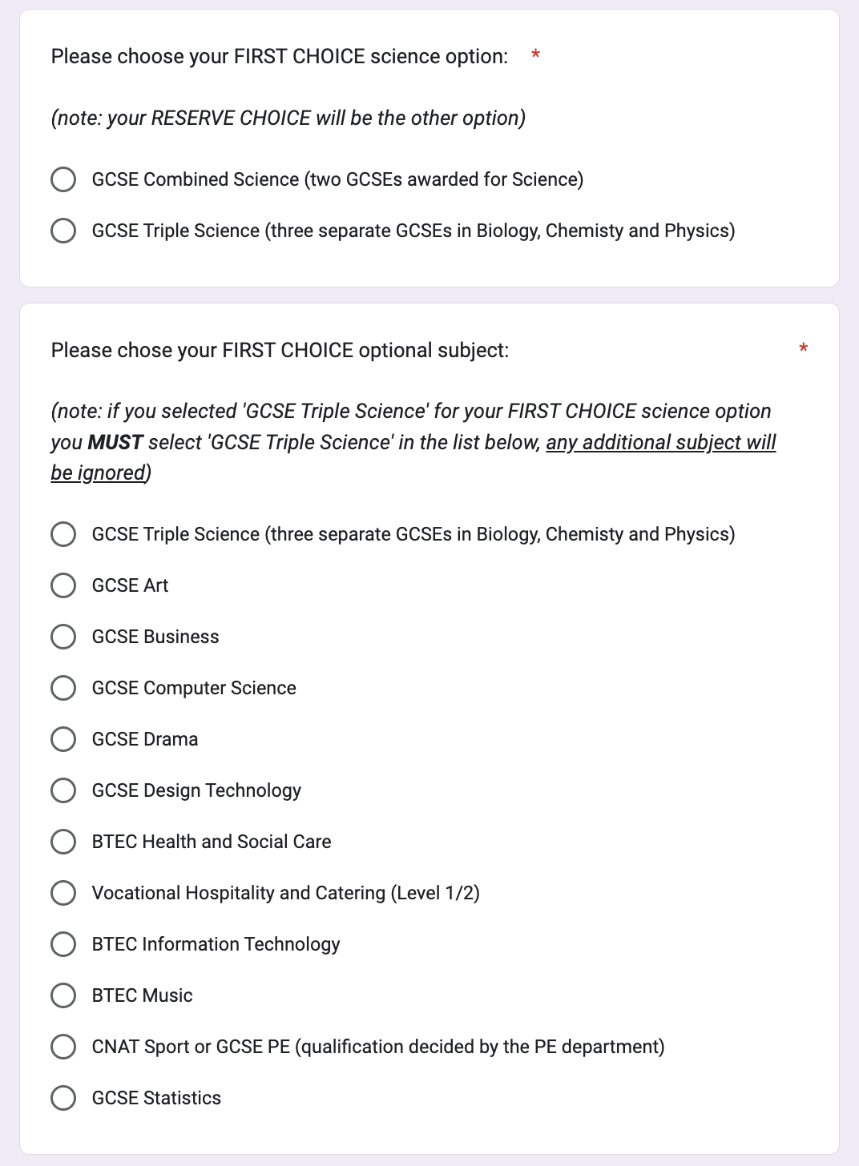
Google Form
Will be sent to pupil email address
Should not be submitted until pupils are absolutely certain (they will not be able to change your mind)
Must be completed in the presence of parent/carer - we will check this
Contains important instructions, if the form is completed incorrectly we will make the decisions on your behalf
Options choices will not be accepted via any other means

Slide 21
KS4 Curriculum Options 2026

Slide 22
Options Timeline
Phase 1 - Information about the process
Phase 2 - Research and Guidance
Phase 3 - Decision Making

Slide 23
Options Phase 1: April 2026
Details of Process and Decisions to be made
Options information for pupils 15th April 2026:
Options briefing
Subject presentations by subject leaders
Parent Briefing 16th April 2026, 5.00pm

Slide 24
Options Phase 2: April 2026
Research, Evidence and Consideration
Option booklet launched on Google Classroom and Pleckgate website Friday 17th April 2026
Year 9 Reports - given out at parents evening 21st April
Tutor group time spent researching on UniFrog
Year 9 Parents’ Evening - Tuesday 21st April 2026

Slide 25
Options Phase 3: February 2024
Decision Making
Google form sent out - Wednesday 22nd April 2026
Deadline for completion of Google form, 3pm 5th May 2026
Optional parents’ meeting with Senior Leadership Team, 14th May 2026
Option choices will be confirmed, in writing, in July 2026

Slide 26
Level 2 Qualifications
Delivered in Year 10 and 11 to give a broad, general knowledge across a range of subjects

Slide 27
What are Level 2 Qualifications?
GCSEs, BTECs, CNATs and Vocational Awards
GCSEs - Grade 9-1, grade 5 is a ‘strong pass’
BTECs/CNATs/Voc Awards - Grades L2D*, L2D, L2M, L2P, L1D, L1M, L1P
Level 2 pass or grade 4 needed to access Level 3 qualifications (A Levels, apprenticeships, BTEC L3) at college
Level 3 qualifications required to progress to Level 4 (Higher Education, University)

Slide 28
What is the English Baccalaureate?
EBACC is a suite of qualifications
Colleges, sixth forms, universities and employers use as selection criteria
Indication of a broad and balanced range of knowledge and skills
Qualifications in English, mathematics, science a humanities subject and a modern foreign language at grade 5 or above

Slide 29
Our Curriculum - Compulsory Qualifications
GCSE English Language
GCSE English Literature
GCSE Mathematics
GCSE Combined Science (2 GCSEs)
GCSE RE
Humanities: choice of GCSE History, GCSE Geography or GCSE Sociology
Language: choice of GCSE French or GCSE Urdu

Slide 30
Our Curriculum - Compulsory Lessons
PSHE - Personal, social and health education
Core PE

Slide 31
Our Curriculum - Optional Qualifications
One additional choice from the following subjects:
GCSE Art
GCSE Business
GCSE Computer Science or CNAT Information Technology
GCSE Drama
GCSE Design Technology
BTEC Health and Social Care
Vocational Award in Hospitality and Catering
CNAT Information Technology
GCSE Music or BTEC Music
GCSE Physical Education or CNAT Sport
GCSE in Triple/Separate Sciences (Biology, Chemistry and Physics)
GCSE Statistics

Slide 32
Putting yourself in the best place for your future
Decision Making

Slide 33
Things to Consider
Grades are usually more important than subjects
In which subjects will you work hardest and perform the best?
Success results from ENJOYMENT
Future study plans and career options
Research thoroughly (3 weeks)

Slide 34
DO NOT
Pick a subject because of somebody else’s reasons
Pick a subject because you like the teacher
Make assumptions without proper research

Slide 35
Important Points
The options process must be followed correctly by all pupils

Slide 36
Important Points
Option choices will only be accepted on the Google form before 5th May 2026
Reserve choices must be stated when requested - these might be what you are allocated
There are no guarantees that an option choice will be offered
Ask for advice from experts and listen carefully
Questions should be directed to Mr Bajkowski or Mr McKenzie

Slide 37
Google Form
Will be sent to your email address
Should not be submitted until you are absolutely certain (you will not be able to change your mind)
Must be completed in the presence of your parent/carer - we will check this
Contains important instructions, if the form is completed incorrectly we will make the decisions on your behalf
Options choices will not be accepted via any other means

