Slide 1
RSE Parents’ Information Evening
Notes:
Ref to appendix

Slide 2
Aims
To give an overview of what RSE is and what the government legislation on it is.
To give an overview of how RSE is taught at Pleckgate.

Slide 3
Introductions
Mrs Jenny Savage- Head of RE
Mrs Shabnum Makda- Parent governor and year 5 teacher at Roe Lee Park Primary School.

Slide 4
What is RSE?
RSE stands for Relationships and Sex Education.
The government brought in a new RSE curriculum in September 2020 and made the ‘Relationships’ part of it compulsory.
The sex education elements are not compulsory and parents have a right to withdraw their child from it. (Excluding the elements covered in science lessons)
Notes:
Ref to appendix

Slide 5
RSE is “lifelong learning about physical, moral and emotional development. It is about the understanding of the importance of marriage and family life, stable and loving relationships, respect, love and care. It is about the teaching of sex, sexuality and sexual health.” (RSE Guidance, DfEE 0116/2000, para. 9 page 5)
Aims
“The aim of RSE is to give young people the information they need to help them develop healthy, nurturing relationships of all kinds, not just intimate relationships. It should enable them to know what a healthy relationship looks like and what makes a good friend, a good colleague and a successful marriage or other type of committed relationship.” (Relationships and Sex Education (RSE) and Health Education Statutory Guidance, p.25, para.1)
The aims of relationships and sex education (RSE) at our school are to:
Foster self-esteem, self-awareness and a sense of personal moral responsibility
Encourage self-respect and consideration for others
Help develop skills in communication, decision-making and assertiveness
Prepare students to avoid unnecessary risks and dangers

Slide 6
How we are implementing RSE at Pleckgate.
We have decided the embed the elements of the new RSE curriculum in our existing whole school curriculum. Majority of these elements are covered in:
- PSHE (through tutor activities, assemblies and super learning days)
- Religious Education
- Science
- ICT
Notes:
Ref to appendix

Slide 7
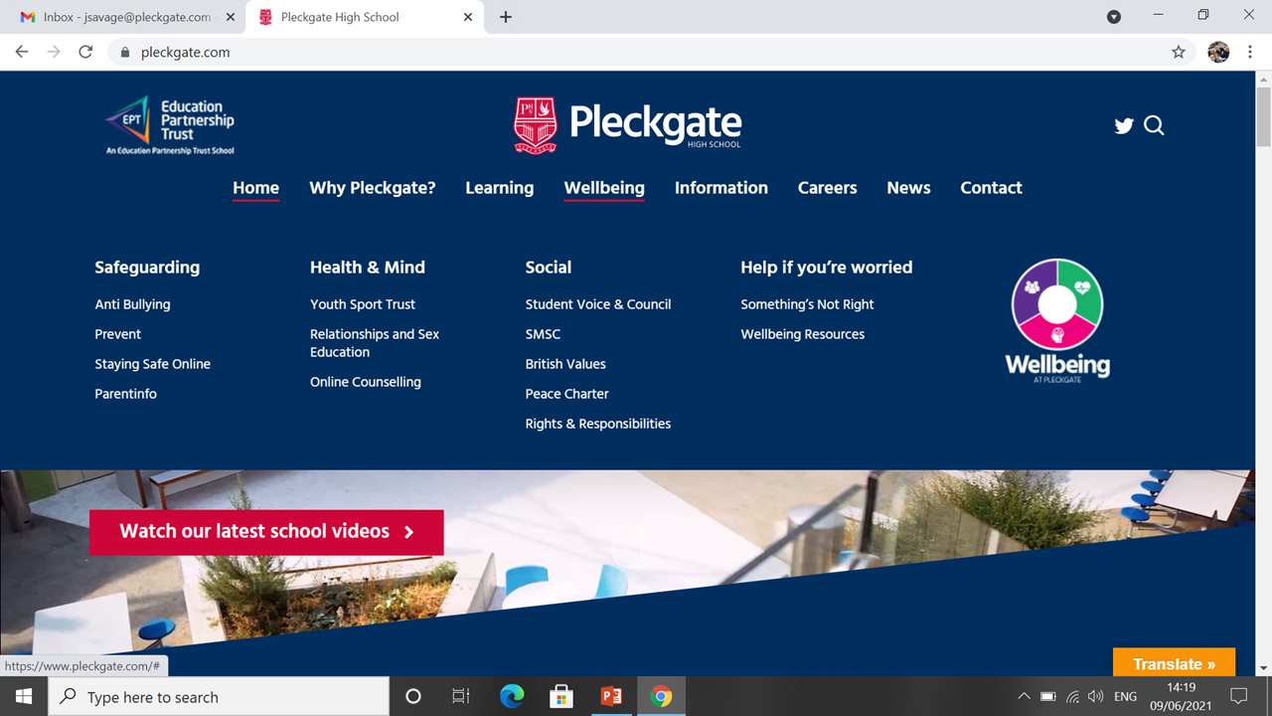

Slide 8
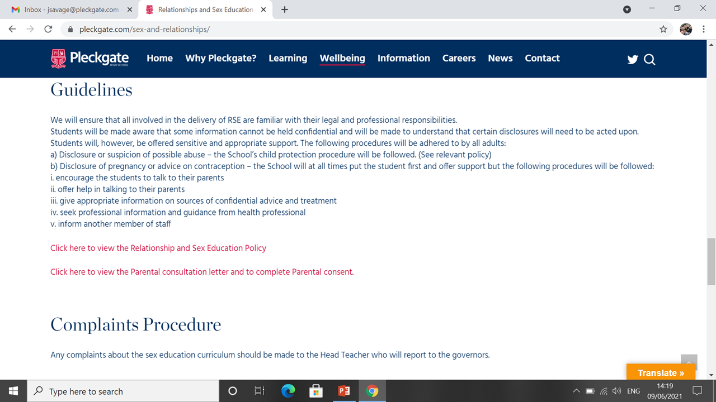

Slide 9
What is actually included in the ‘Sex Education’ part of Relationships and Sex Education?

Slide 10
DfE Wording | Subject | Year Group | Overview
1.1 What constitutes sexual harassment and sexual violence and why these are always unacceptable | PSHE | Year 10
1.2 That specifically sexually explicit material e.g. pornography presents a distorted picture of sexual behaviours, can damage the way people see themselves in relation to others and negatively affect how they behave towards sexual partner | PSHE | Year 10 | This is delivered on a super-learning day which is off-timetable. Students learn about the misconceptions associated with pornography. STUDENTS DO NOT SEE EXPLICIT IMAGES OR VIDEOS AS PART OF THIS EDUCATION.
1.3 The concepts of, and laws relating to, sexual consent, sexual exploitation, abuse, grooming, coercion, harassment, rape domestic abuse, forced marriage, honour-based violence and FGM, and how these can affect current and future relationships | PSHE Assemblies | Year 10 Year appropriate | BROOK deliver a session on sex and the law Some of these other concepts are delivered by SLT in assemblies in an age-appropriate way.

Slide 11
DfE Wording | Subject | Year Group | Overview
1.4 How people can actively communicate and recognise consent from others, including sexual consent, and how and when consent can be withdrawn (in all contexts, including online) | PSHE | Year 10 | BROOK deliver a session on sex and the law
1.5 How to recognise the characteristics and positive aspects of healthy one-to-one intimate relationships, which include mutual respect, consent, loyalty, trust, shared interests and outlook, sex and friendship | RE | Year 7 | Healthy and Unhealthy relationships- students look at different types of abuse in relationships. Sexual abuse is mentioned but this is not the main focus of the lesson. The lesson just makes students aware that sexual abuse is wrong.
1.6 That all aspects of health can be affected by choices they make in sex and relationships, positively or negatively, e.g. physical, emotional, mental, sexual and reproductive health and wellbeing | PSHE | Year 10 | BROOK deliver this as part of their session on healthy relationships. Students will look at a range of STI’s and what impact these can have on health.
1.7 That there are a range of strategies for identifying and managing sexual pressure, including understanding peer pressure, resisting pressure and not pressurising others | PSHE | Year 10 | BROOK deliver this as part of their session on healthy relationships. This is also covered in the ‘Making sense of relationships’ lesson.

Slide 12
DfE Wording | Subject | Year Group | Overview
1.8 That they have a choice to delay sex or to enjoy intimacy without sex | PSHE | Year 10 | BROOK deliver this as part of their session which looks at choices of when or when not to start intimate relationships. This is also covered in the ‘making sense of relationships’ lesson.
1.9 The facts about the full range of contraceptive choices, efficacy and options available | RE Science Biology | Year 10 Year 7 Year 10 | Marriage and the Family: Christianity. Students learn about the different types of contraception and then learn about the different Christian teachings on these as well as Muslim teachings. Human Reproduction CAN NOT WITHDRAW CHILD FROM Hormonal Co-ordination CAN NOT WITHDRAW CHILD FROM

Slide 13
DfE Wording | Subject | Year Group | Overview
2.0 How the different sexually transmitted infections (STIs), including HIV/AIDs, are transmitted, how risk can be reduced through safer sex (including through condom use) and the importance of and facts about testing | RE PSHE Biology | Year 10 Year 10 Year 10 | Marriage and the Family: Christianity. When students learn about the different types of contraception we discuss which of them prevent sexually transmitted diseases (STI’s) BROOK deliver this as part of their session on healthy relationships. Communicable Diseases CAN NOT WITHDRAW CHILD FROM
2.3 About the prevalence of some STIs, the impact they can have on those who contract them and key facts about treatment | RE PSHE Biology | Year 10 Year 10 Year 10 | Marriage and the Family: Christianity. When students learn about the different types of contraception we discuss which of them prevent sexually transmitted diseases (STI’s) and the impacts STI’s can have on people. BROOK deliver this as part of their session on healthy relationships. Communicable Diseases CAN NOT WITHDRAW CHILD FROM

Slide 14
DfE Wording | Subject | Year Group | Overview
2.4 How the use of alcohol and drugs can lead to risky sexual behaviour | Biology | Year 10 | Communicable Diseases CAN NOT WITHDRAW CHILD FROM
2.5 How to get further advice, including how and where to access confidential sexual and reproductive health advice and treatment | RE PSHE | Year 10 Year 10 | Marriage and the Family: Christianity. When students learn about the different types of contraception, we end the lesson with a PowerPoint slide directing them to BROOK for more information. BROOK also promote their organisation as part of their session and what advice and services they offer which is open to all students.

Slide 15
Why does this need to be taught in school?
In today’s multi-media society, young people are exposed to a vast amount of information about relationships and sex and this can sometimes make an already confusing time seem even more complicated.
All teaching materials are appropriate to the age and emotional maturity of the pupils concerned and the professionally trained external providers (BROOK) and teachers will present the information in an objective, balanced and sensitive manner.

Slide 16
Questions
Please email jsavage@pleckgate.com.

