Slide 1
TRANSITION EVENING:PARENTS’ MEETING

Slide 2
Transition Evening
Who’s Who
The Day So Far
Information for Parents
Pastoral System: Behaviour For Learning: Homework: Routines: Equipment: Uniform: Attendance
Any Questions

Slide 3
Tutor - Tutor Base
Mrs McGinty - Head Teacher
Tutor
Mrs Millest - Head Of Year
Mrs Patel - Pastoral Support
Miss Langfeld - SendCo

Slide 4
Transition Day
The children have had a very successful Day
They have been introduced to lots of new staff, made new friends and have already started to follow some of Pleckgate’s routines
They have worked hard with many different activities: Icebreakers: Tour of the school: Full year assembly: Time Capsule letters: Art Work: Break and dinner times: Began Summer Reading Project

Slide 5
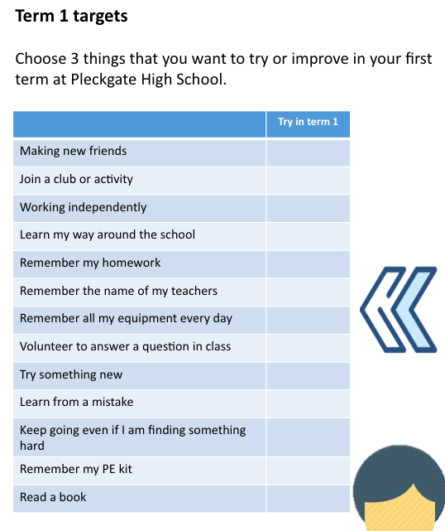
Transition Activity

Slide 6
Pastoral System
The year group consists of 270 pupils
Year 7 has 10 tutors each with 27 pupils (mixed ability and primary schools)
Tutor Group remains the same with the same tutor and head of year for 5 years
The tutor group meets every day for 20-25 minutes with one assembly a week for the whole year group

Slide 7
Pastoral System
Tutors should be the first contact for parents and pupils. Email is recommended
Pupils have and will continue to be encouraged to speak to tutors regarding any issues that arise
Prefects will also be assigned to each tutor group to provide support especially during the first few weeks and months.

Slide 8
Pastoral System
Pastoral Support is attached to every year group. Mrs Patel is the Year 7 Pastoral Support Officer.
Her role is varied and includes pastoral support, as well as behaviour intervention. Her role is to support year 7 pupils, tutors, year 7 teachers, and head of year in many different ways.

Slide 9
Pastoral System
Behaviour for learning
Pleckgate promotes outstanding behaviour. All behaviour is monitored through Edulink and communicated to parents and teachers
Achievement Rewards: Based on the number of achievement points received or for a one off specific event.
Prizes - including footballs, stationery, “star of the week”, breakfast with the head, certificates, trips, prize draw every term (also for 100% attendance)

Slide 10
Pastoral System
Promoting Behaviour For Learning
A behaviour point is given if a pupil displays poor behaviour. This is recorded on the school’s Edulink system
Pupils have been told today about the 4 stage system.
Stage 1 - First Warning
Stage 2 - Minor sanction given by the teacher
Stage 3 - Detention with the teacher
Stage 4 - Hour after school with the teacher
For more serious and persistent issues pupils are placed in an isolation room

Slide 11
Pastoral System
Promoting Behaviour For Learning
The head of year, LPSO and tutors monitor achievement and behaviour daily.
Each week the achievement and behaviour points are counted.
Rewards are given to those who have earned the highest number
of achievement points
Pupils who have been given 3 or more behaviour points in a week could be placed on a monitoring report. Parents will be notified of this by text or email.

Slide 12
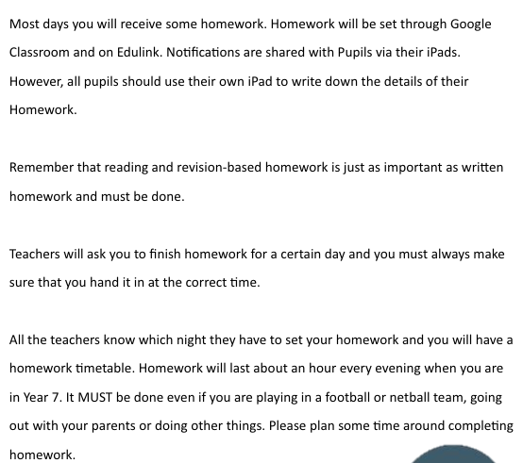
Homework

Slide 13
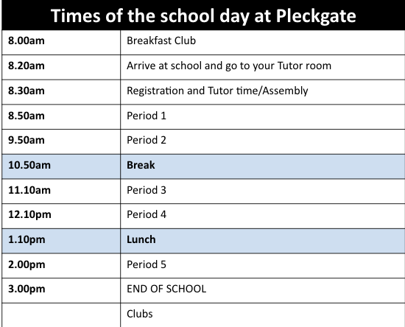
Routines - School Day
8.20 Start: Tutors will meet pupils at their tutor bases.
All pupils should be seated at 8.30

Slide 14
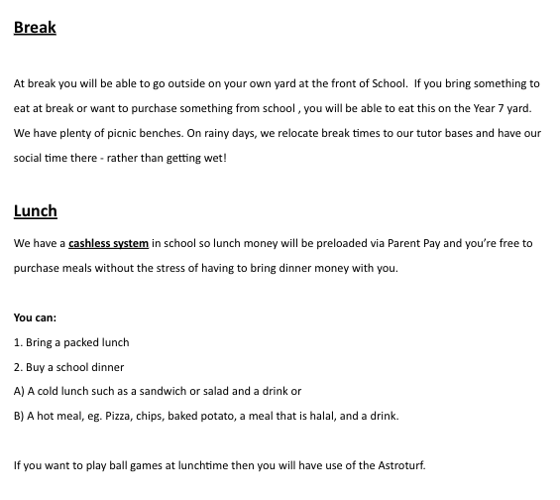
Break & Dinner

Slide 15
Equipment

Slide 16
What not to bring

Slide 17
Uniform - Compulsory for all Pupils
Coat - Navy blue or black only. Suede, leather, denim, hooded tops, jackets with large logos and graffiti are not permitted
Blazer - Compulsory. With Pleckgate High School Logo. A coloured badge will be provided by the school to identify the year group
Jumper - Compulsory. Navy Blue with embroidered school badge
School Tie (Clip on)
Shirt - Plain White with collar and long or short sleeves. Not Tee shirt or aertex type
Trousers - Navy blue straight legged trousers. (not denim,skinny fit or leggings) Trousers must also be full length
Skirt - Navy Blue pleated with embroidered badge worn at knee length. The wearing of navy blue trousers (plain, straight legged) underneath the skirt is permitted

Slide 18
Uniform - Compulsory for all Pupils
Socks. White or Navy knee length socks. Plain black tights.
Shoes. Plain Black smart shoes (no logos, heels or boots). No trainers
Headscarves. Headscarves must be the approved design purchased from the school shop
PE Kit. Blue sports top with white piping, red flanks and school logo. Navy blue shorts or navy blue tracksuit bottoms with embroidered school badge. Navy blue socks
A no jewellery rule operates for all pupils, including earrings. Pleckgate supports the wearing of items of religious significance such as the Taweez, Kangha, Kirpan and Kara
Fake Nails, nail polish and make up are not permitted
Extreme haircuts, lines in hair and dyed hair are not permitted

Slide 19
Attendance
Days off school add up to lost learning
175 non-school days in a year 175 days to spend with family, holidays, visits, shopping, household jobs and appointments.
0 Days Absence (190 school days) 100% Outstanding Attendance Great chance of success | 6 Days Absence or more 97% Good Attendance Your Target Good chance of success | 10 Days Absence or more 95% Could be better Less than 95% will impact on your achievement | 19 Days Absence or more Below 90% (Persistent Absence) Cause for Concern Greatly impacts on achievement

