Slide 1
Primary
Secondary
Pleckgate High School
Name:
Form Tutor:

Slide 2
Welcome to Pleckgate High School!
Soon you will become a member of Pleckgate High School and we hope that you will settle into the school routine very quickly.
This short booklet contains all the information that you will need to help you through the first few weeks at Pleckgate. Remember, if you have any problems or need advice then ask your Tutor, Head of Year or any member of the school staff.
^{Who’s who?}
Head Teacher: Mrs A McGinty
Deputy Head Teachers: Mr R Hamilton
^{Mr J McKenzie}
Head of Year for Year 7: Mrs Millest
Year 7 Pastoral Support: Mrs Patel
^{Year 7 Tutors:}
Mrs Benjelloun | NBE | G34
Mrs Hughes | THU | G30
Mrs Nath | ENA | G24
Mrs Wilson | GWS | G29
Mrs Birbeck | MBI | G28
Miss Cuthbert | NCU | G31
Mr Smith | JOS | G27
Mrs Fareed | SFA | G37
Mr Mirza | SMI | G35
Mrs Patel | ZPA | G32

Slide 3
It is a very special time for you as a new Year 7 pupil. When you arrive at Pleckgate High School, you will join Year 7 and a Tutor Group of about 27 pupils. There will be a total of 10 Tutor Groups in your year.
Your Tutor Group is named after your tutor and the year number. So 7THU is a Year 7 Tutor Group belonging to Mrs T Hughes.
Usually there will be someone from your Primary School in the same Tutor Group as you; however, this person may not be your special friend. Remember that you are moving to a new and bigger school and that this is a time when you have a chance to make new friends as well as continuing with old friendships. You can always meet your old friends at break and at dinner time.
You will be taught as a Tutor Group for some of your lessons and so you will soon learn all the names of the people you meet every day. Every morning from 8.20 am you meet your Tutor in your Tutor Base, so
this is the time to ask your Tutor for any help that you need. If you need to see the Year 7 Head of Year, Mrs Millest, then you can go during Tutor Group time or at break to her office.

Slide 4
^{Who can help me in my school?}
Job | Role
Form Tutor
Head of Year
LPSO
Teacher
Receptionist
Headteacher
Deputy Headteacher
SENDCO
Now try to think of another person in school who can help you.
Name:..............................................................................................
Job: .................................................................................................

Slide 5
On your first day in September you will receive a timetable from your
Tutor. You will make a copy of this on your iPad.
Your new school day will look like this:
Times of the school day at Pleckgate
8.00am | Breakfast Club
8.20am | Arrive at school and go to your Tutor room
8.30am | Registration and Tutor time/Assembly
8.50am | Period 1
9.50am | Period 2
10.50am | Break
11.10am | Period 3
12.10pm | Period 4
1.10pm | Lunch
2.00pm | Period 5
3.00pm | END OF SCHOOL
 | Clubs

Slide 6
^{Break}
At break you will be able to go outside on your own yard at the front of School. If you bring something to eat at break or want to purchase something from school , you will be able to eat this on the Year 7 yard. We have plenty of picnic benches. On rainy days, we relocate break times to our tutor bases and have our social time there - rather than getting wet!
^{Lunch}
We have a cashless system in school so lunch money will be preloaded via Parent Pay and you’re free to purchase meals without the stress of having to bring dinner money with you.
^{You can:}
^{1. Bring a packed lunch}
^{2. Buy a school dinner}
A) A cold lunch such as a sandwich or salad and a drink or
B) A hot meal, eg. Pizza, chips, baked potato, a meal that is halal, and a drink.
If you want to play ball games at lunchtime then you will have use of the Astroturf.

Slide 7
^{Equipment to bring to school:}
You will need to have a good strong waterproof school bag to carry lots of equipment around with you.
^{In this bag you will need:}
^{A pencil}
^{Pens}
^{Pencils}
^{Pencil sharpener}
^{Ruler}
^{Rubber}
^{Protractor}
^{Compass}
^{Set square}
^{Set of coloured pencils}
^{Also:}
^{Scientific calculator}
iPad - fully charged (iPad will be supplied by school)
^{What not to bring to school:}
^{Felt tip pens/Felt tip markers}
^{Liquid paper/Tippex}
^{Chewing gum/Bubble gum}
^{Make–up}
^{Nail varnish}
^{Coloured outdoor coats}
Hand held games consoles / music players
Jewellery—including earrings and nose studs

Slide 8
^{Prepare For Learning}
Classroom Expectations — as agreed by The School Council
^{1. Arrive to lessons on time.}
2. Enter the room at the beginning of the lesson in an orderly manner.
3. Get all books and equipment out on entry to the room:
^{Stationery equipment}
^{iPad}
^{Exercise book}
^{4. Always give of your best.}
5. Follow instructions first time given.
6. Treat everyone with respect, including yourself.
7. Use Standard English, not slang, when speaking in class.
8. Present your work in the best possible manner.
9. If you have to leave the lesson ensure your Planner is signed to explain why.
10. Stand behind your chair to be dismissed.
Rules for movement around school
1. Walk calmly and sensibly to lessons.
2. Always follow the ONE way system
3. Walk on the left hand side in the corridor.
4. Go by the most direct permissible route to your lesson.
^{School Rules}
1. No phones or electronic devices to be used in the school building.
2. No chewing gum is allowed in school.
^{3. No smoking or E-Cigarettes.}
4. No makeup or nail varnish is allowed.
5. No jewellery other than a wrist watch.
^{6. No Lines in your hair.}

Slide 9
^{Achievement Rewards}
Points are collected for good behaviour or achievement and these can be exchanged for items such as gift vouchers, footballs, stationery, rewards trips, certificates, positive phone calls home etc.
Star of the week - - Get your picture on our wall of fame!
^{Behaviour Systems—Stages}
Pleckgate promotes outstanding behaviour. Our behaviour monitoring system is one based on “Behaviour for Learning,” recorded on the school’s Edulink system. If you choose to display poor behaviour there will be consequences based on a “Stages System”.
The different stages are as follows:
^{Stage 1 - First warning}
Stage 2 - Minor sanction given by the teacher
Stage 3 - Detention with the teacher
Stage 4 - Pupil removed from class and 1 hour detention given with the teacher.
If your behaviour is extremely poor this may result in you being in isolation for the rest of the lesson or even the day.

Slide 10
^{Homework:}
Most days you will receive some homework. Homework will be set through Google Classroom and on Edulink. Notifications are shared with Pupils via their iPads. However, all pupils should use their own iPad to write down the details of their Homework.
Remember that reading and revision-based homework is just as important as written homework and must be done.
Teachers will ask you to finish homework for a certain day and you must always make sure that you hand it in at the correct time.
All the teachers know which night they have to set your homework and you will have a homework timetable. Homework will last about an hour every evening when you are in Year 7. It MUST be done even if you are playing in a football or netball team, going out with your parents or doing other things. Please plan some time around completing homework.

Slide 11
Uniform
Coat | Navy blue or black ONLY. Suede, leather, denim, hooded tops, jackets with large logos and graffiti are NOT permitted.
Blazer | Compulsory. Navy blue with embroidered school badge. A coloured badge will be provided by the school to identify the year group.
Jumper | Compulsory. Navy blue with embroidered school badge.
Tie | School design only. (clip on tie)
Shoes | Black flat shoes – these should be cleaned regularly. Boots, casual shoes or training shoes are NOT permitted.
Shirt | Plain white, cotton or polyester not aertex or tee shirt type.
Skirt | Navy blue pleated with embroidered badge worn at knee length. The wearing of navy blue trousers (plain straight legged) underneath the skirt is permitted.
Trousers | Navy blue straight legged trouser (not skinny fit or ‘jean’ type material).
Socks | White or navy blue knee length socks.
Headscarves | Headscarves must be the approved design purchased from the school shop.
PE Kit | Blue sports top with white piping, red flanks and school logo. Navy blue shorts or navy blue tracksuit bottoms with embroidered school badge. Navy blue socks.
Jewellery | A no jewellery rule operates for all pupils, including earrings. Pleckgate supports the wearing of items of religious significance such as the Taweez, Kangha, Kirpan and Kara.

Slide 12
^{What to do if…}
YOU ARRIVE AT SCHOOL AFTER 8.30am - give your name to the members of staff on duty in Reception then go to Tutor Group or wait outside the Main Hall if it is Assembly.
YOU ARRIVE AFTER 8.50am - you should log in on the InVentry System at Reception, go to your lesson and bring a note for your Tutor the following morning.
YOU GET LOST - ask the nearest member of staff or the Prefects or go to Reception.
YOU ARE WORRIED ABOUT ANYTHING, INCLUDING BULLYING - ask your Tutor or Mrs Millest or the Anti Bullying Ambassadors (you will be told about this later).
YOU ARE ABSENT FROM SCHOOL - ask your parent or carer to ring the absence line on 01254 249134 (press option 1) and bring a note for your Tutor on the day that you return to school.
THE FIRE ALARM RINGS - listen to the teacher, keep calm and follow the Fire Instructions. You must line up in your Tutor Groups on the courts at the rear of school.
YOU NEED TO GO TO THE TOILET - use the closest toilets that you have been shown to use. Do this at break or at lunch.
YOU FEEL ILL - tell the teacher if you are in class or your Tutor or Mrs Millest if you are out of class, who will seek the advice of a First Aider.
YOU LOSE ANYTHING - go to Reception to ask about Lost Property, preferably at dinner time.

Slide 13
^{Extra Curricular}
There are many different extra curricular activities that will be on offer to you in September and over the course of the year. Some of these take place at lunchtime and some after school. It is important that not only do you do well in your studies but you also get involved in school life. Even if you have not got involved with such activities in your Primary School this will be an excellent opportunity for you to develop existing skills, learn new skills and even make new friends!
Examples of activities on offer to you:
^{SPORTS:}
Netball, Football, Badminton, Cricket, Rounders, Basketball, Dance, Table Tennis, Fitness, Athletics, Gymnastics.
^{DRAMA:}
Drama Club, involvement in School Productions.
^{MUSIC:}
Learning to play musical instruments: ukulele, Keyboards, trumpet, drums, guitar, singing, Extra Curricular Clubs—bands, school choir, school productions
^{OTHER:}
Dance club, Eco Club, History Club, Craft Club, Chess Club, Top Trumps, Needlecraft, Charity Club.
There are many more clubs that will be on offer.
Make sure you attend at least one!

Slide 14
On your journey to starting year 7 in our school mark out some key life events that you would like to share with us. What things have stood out to you?
Year 1 in Primary school
Starting Year 7

Slide 15
Colour in Pleckgate’s logo
Can you write the school’s values around the badge?

Slide 16
So that your form tutor can get to know you better please can you fill in your information map below.
My Family
What village/town/city I live in:
What subject I find hard…
My birthday is
Name:
What are my favorite subjects….
What makes me happy is . . .

Slide 17
Term 1 targets
Choose 3 things that you want to try or improve in your first term at Pleckgate High School.
 | Try in term 1
Making new friends
Join a club or activity
Working independently
Learn my way around the school
Remember my homework
Remember the name of my teachers
Remember all my equipment every day
Volunteer to answer a question in class
Try something new
Learn from a mistake
Keep going even if I am finding something hard
Remember my PE kit
Read a book

Slide 18
Moving to a new school whether it is with your friends or not means you will be making new friends.
Here are some tips on how to make new friends. Choose one that you think you are already good at, explaining why. Then choose one you are going to try in your first term of Pleckgate High School and how you will try it out.
Friends tips | Explanation
Smiling
Asking questions
Offering help to others
Joining a club/activity
Sharing equipment
Being kind to others

Slide 19
Have a think about your first day at Pleckgate High School. What do you think you will need to pack in your bag for the day? Draw or write each item around the ruck sack.

Slide 20
Some pupils think when you move up to secondary school you no longer need a pencil case. But at Pleckgate High School we still love pencil cases! Colour in this pencil case and the equipment you will need in it. Then you will know what to pack in your pencil case.

Slide 21
Morning routine:
Before leaving for School there are a lot of things to think about, starting from the night before.
Here are some things to think about .
•Get dressed
•Check you have the correct equipment in your bag
•Wash
•Check you have got your homework
•Clean your teeth
•Check you have the correct money
•Wake up
•Eat your breakfast
•Say “Goodbye” and leave for School
Plan your morning routine with approximate times.
Time | What to do

Slide 22
FAQ: Here are some answers to frequently asked questions from new pupils to Pleckgate High School.
“What will happen if I get lost?” Everyone gets lost at first, but Pleckgate High School is not that big, you will learn where to go. You can ask any member of staff or older pupil who will point you in the right direction
“What will happen if I forget my pencil case?” You need to tell your form tutor and remember to put it in your bag when you go home.
“What will happen if I am late to a lesson?” In the first few weeks teachers understand you will forget things and get lost so do not worry. After the first few weeks we do expect you to be on time to every lesson.
“What will happen if I forget my homework?” Teachers will give you time to get used to secondary school. The practice will help you keep organised.
“Will I get asked lots of questions in my lesson?” Teachers love to hear from their pupils but it is fine not to know an answer. Your teacher will ask everyone not just you.
“Will my lessons be really hard?” Your lessons should teach you something new, which can be a challenge at times. This is a good thing, this is how we learn.
“Will I make new friends?” Making new friends is part of the transition to a new school. You can join clubs to help you make new friends.

Slide 23
Find out about us: Here are some programs and activities that we do at Pleckgate High School, can you find out what they are? Try researching on the internet.
Borrow Box: ____________________________________________________________________________________
Edulink: ____________________________________________________________________________________
Google Classroom:
____________________________________________________________________________________
Seneca:
____________________________________________________________________________________

Slide 24
Coming to a new school can be full of unknowns, this creates a new adventure which can be fun. However, I expect you will have a lot of questions. Use the space below to write some questions for your form tutor.
__________________________________________________________________________________________________________________________________________________________________________________________________________________________________________________________________________________________________________________________________________________________________________________________________________________________________________________________________________________________________________________________

Slide 25
Tour of the School Quiz!
1. What might you find above reception?
2. What colour are the benches that you might sit on to eat your lunch?
3. What are the big open circular areas called in school?
4. Where might you find the finger print machines?
5. How many finger print machines are there?
6. Where is the library?
7. Where is the year 7 playground situated?
8. Where are the MUGAs?
9. Where are the IT rooms?
10. Where do you line up?

Slide 26
Tour of the School Quiz!
11. Where and what is the amphitheatre?
12. What is in the winter garden? List as many items as you can.
13. How many small screens make up the large screen on the wall in the dining hall?
14. How many indoor areas are there for PE?
15. Where are your toilets?
16. Where will your assembly take place each week?
17. What is the school motto?
18. Where is Mrs Millest’s office?
19. Where is lost property?
20. Where do I go if I have a problem with my iPad?

Slide 27
Your Tutor Group:
Your tutor is going to be like your family while you are at Pleckgate High School.
It is important to have tutor rules to make sure everyone is respected and happy.
Fill in each star with a rule that you think your form should have. An example could be “Do not interrupt the person talking”.

Slide 28
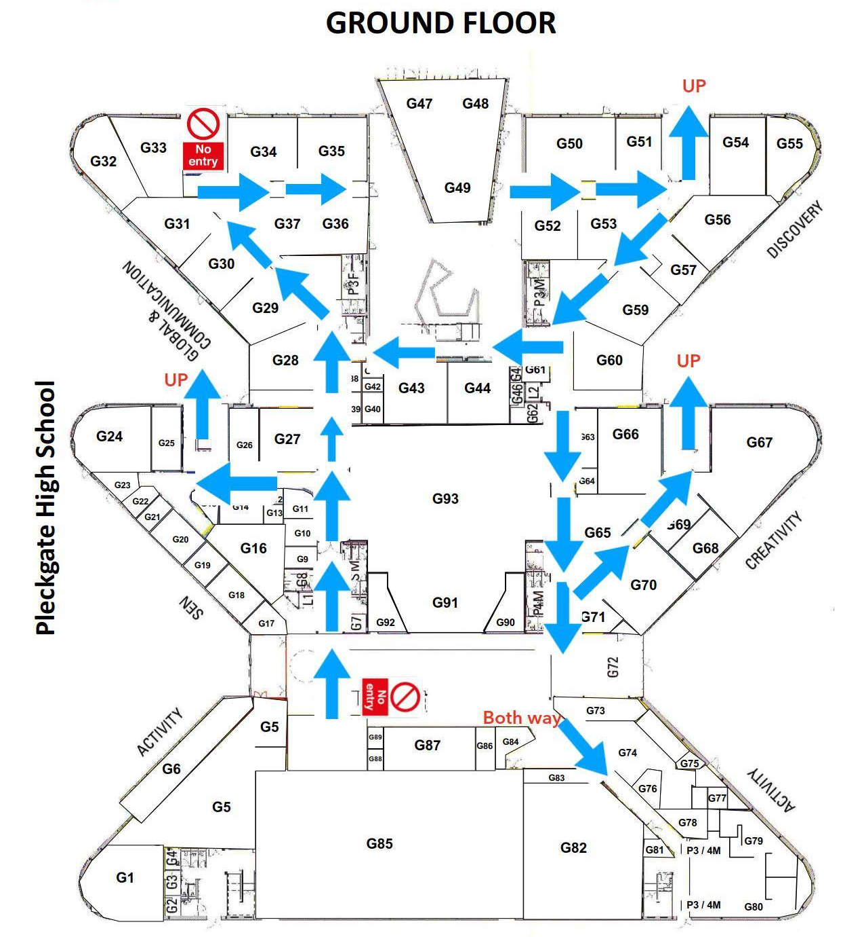

Slide 29
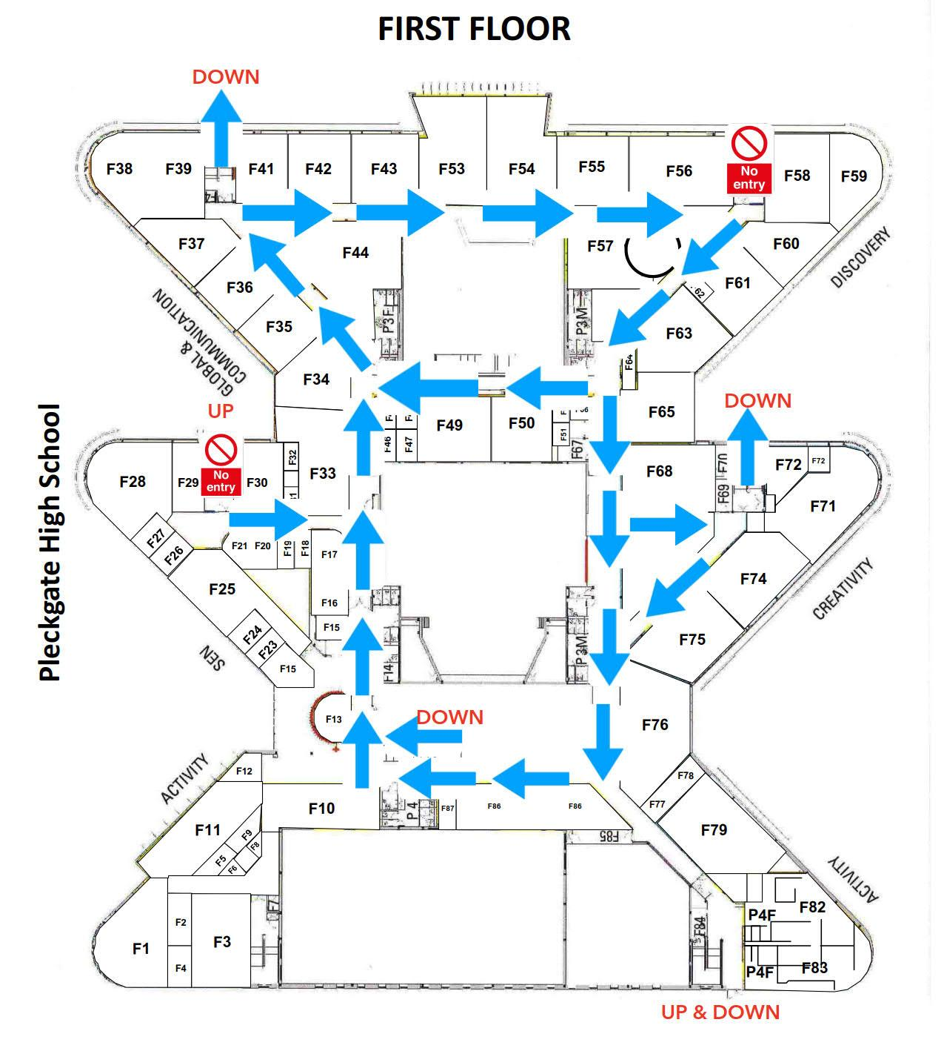

Slide 30
Write a letter to your new form tutor telling them about yourself. You could tell them about your family or pets, about your hobbies or what you have been up to over the summer holiday.
Dear tutor,
______________________________________________________________________________________________________________________________________________________________________________________________________________________________________________________________________________________________________________________________________________________________________________________________________________________________________________
________________________________
________________________________
Yours faithfully,

