Slide 1
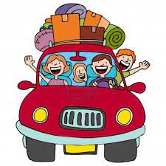
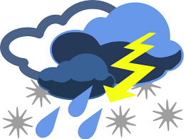
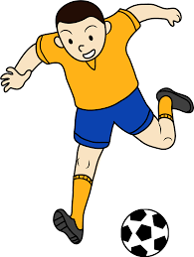
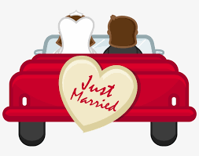
FRENCH AT PLECKGATE
YEAR 10 LEARNING JOURNEY
Talking about travelling
Conditional tense
Holiday problems
Perfect tense
Countries and activities
End of Year Exams
YEAR
11
Speaking exam questions
Dream holidays
Conditional tense
Describing a holiday in 3 tenses
Exam skills
Describing a region
Future activity plans
Conditional and simple future tenses
Weather
Si clauses
Holidays
My Region
Advantages and disadvantages of a region
Speaking exam preparation
Food for special occasions
Present & perfect tenses
Food
Present & perfect tenses
Lead charity fundraising
End of Unit Assessments
Listening and Reading
Festivals and traditions
Perfect and imperfect tenses
Family celebrations
Perfect and imperfect tenses
Speaking exam preparation
Festivals & Food
Sports
jouer and faire
Extreme sports
Uses and advantages and disadvantages of social media
Irregular present tense verbs
Reading and Music
Imperfect past tense
Free time activities and technology
Giving opinions about film and TV
Uses and advantages and disadvantages of mobile technology
Negatives
End of Unit Assessment:
Reading and Writing
Describing a day out with friends
Perfect past tense
Relationships with family and friends
Family & Relationships
Speaking exam preparation
Marriage and opinions
Immediate future tense
Arranging to go out
Immediate future tense
Describing people
The following skills will be incorporated into all lessons:
listening, speaking, reading and writing (including translation).

