Slide 1
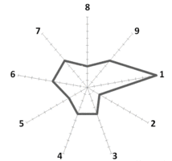
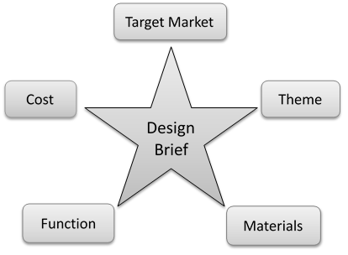
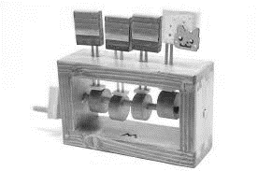
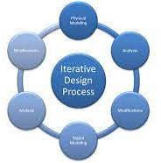
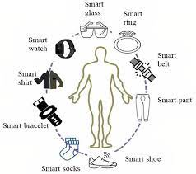
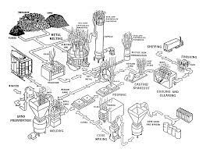
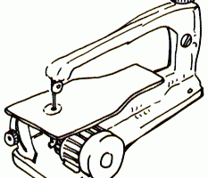
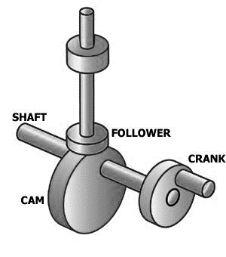
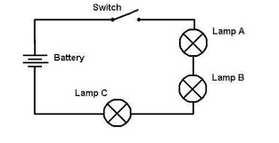
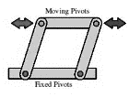
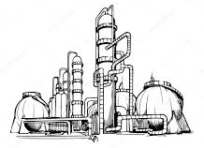
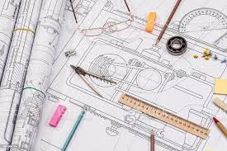
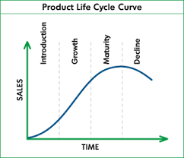
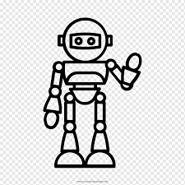
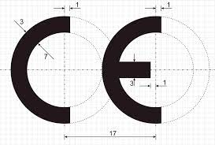
Design Technology AT PLECKGATE
YEAR 10 LEARNING JOURNEY
D&T offers you a curriculum which will engage and enthuse a passion for the subject. Giving you the opportunity to explore practical activities which will enable you to master the skills and secure your knowledge.
Related product analysis
Product Evaluation
Task analysis
Design Brief
Product modifications
Design modifications
YEAR
Non Examined Assessment
(Manufacture)
Non Examined Assessment
(Design)
11
Specialist Exam Content
HT6
Product Specification
Exam questions
Market Research
Research Analysis
Specialist
Exam
Content
Iterative design
Forming
Manufacture skills
Automation
Upcycling
Types of Finish
Textiles
HT5
Exam Questions
Non Examined Assessment (Research)
Exam Questions
Smart materials and properties
Design Math
Graphic
finish
Manufacturing methods
Ergonomics
Risk assessment
Life cycle
analysis
Polymer products and processes
Polymer properties and sources
Paper and card properties
Quality Assembly
Drilling
Core
Exam
Content
HT4
Flowchart
Planning
Lead charity fundraising
Materials
Sustainability
Modelling
Ferrous & Non Ferrous metals
Timber products and joints
Accuracy of finish
Fixings
Timber properties and sources
Wasting techniques
Core
Exam
Content
Manufacture
Cams
Circuit diagrams
Tools
Fret Saw
Design modifications
Health and safety
Core
Exam
Content
Buzzer Game
Core exam content
HT3
Mechanisms
Marking out
Isometric
Drawing
Pillar drill
Machine tools
Electronics
Linkages
Iterative design
HT2
Mood Boards
Planned obsolescence
Life cycle
analysis
Fuels
Trinket Box Project
AI & AR
YEAR
Trinket Box
Core exam content
10
Energy Sources
Production techniques
Design
Sustainability
Social moral issues in designing
PPE
Design ideas
Design • Knowledge • Manufacture • Evaluate

