Slide 1
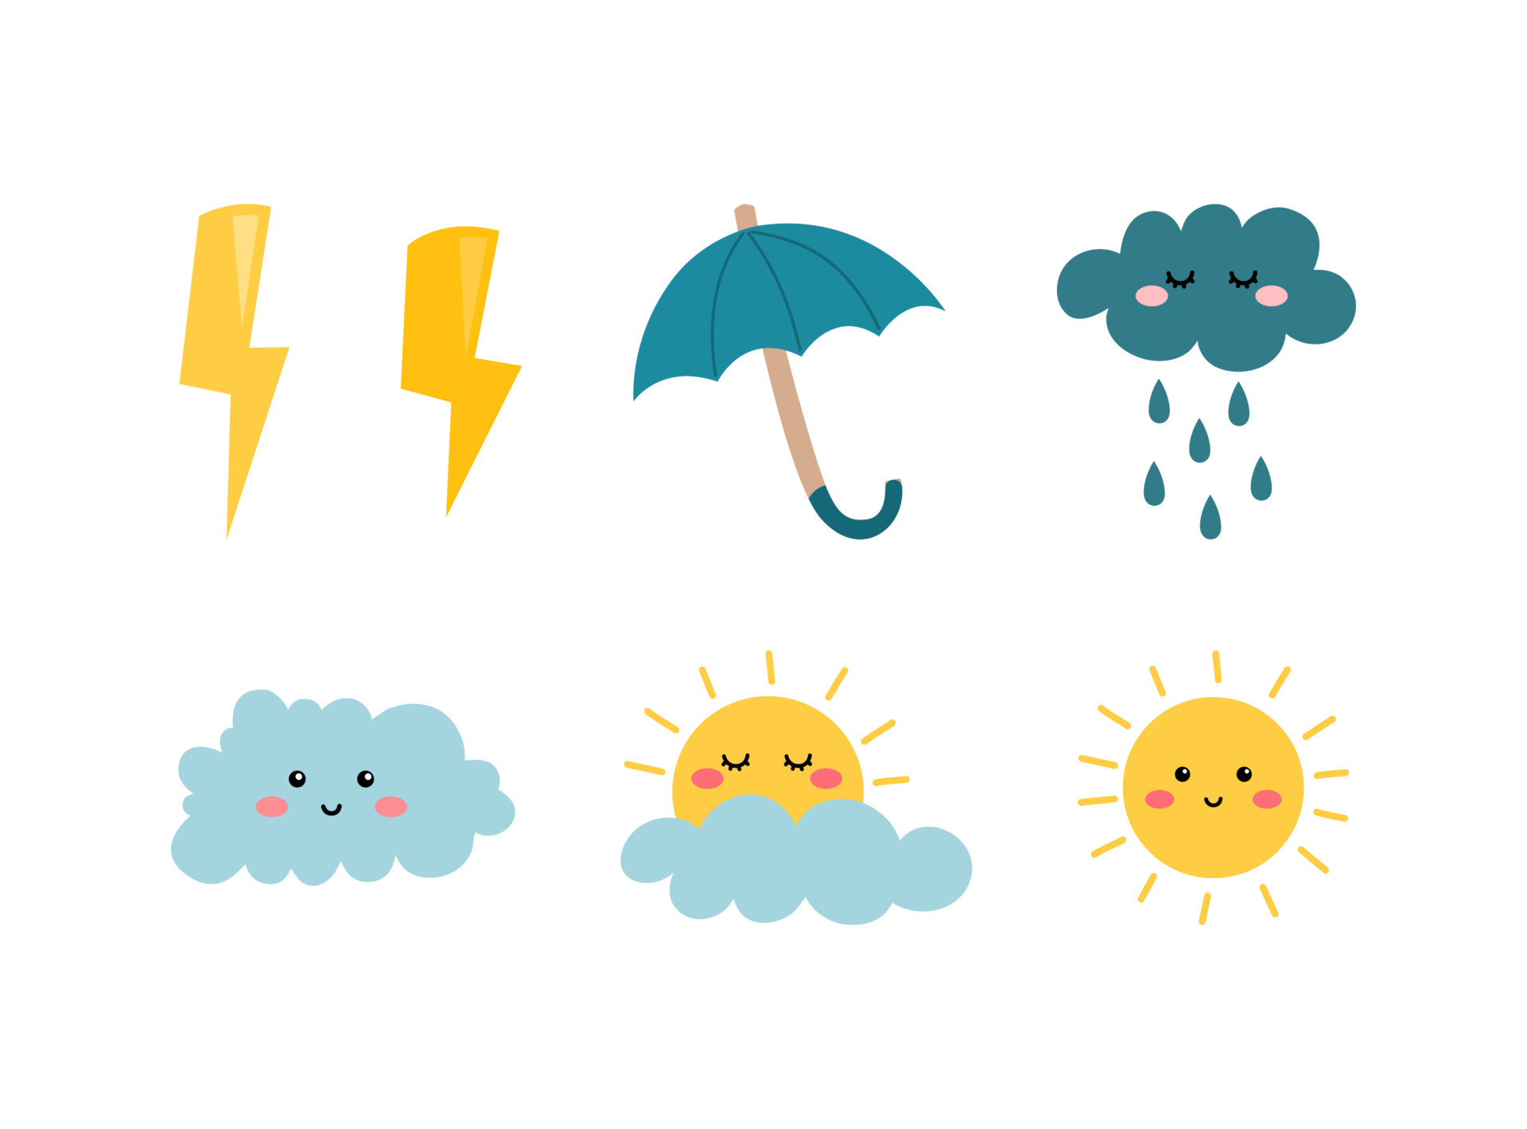
\
FRENCH AT PLECKGATE
YEAR 7 LEARNING JOURNEY
End of year assessments
Using Il y a and il n’y a pas de
Conjugating aller in the present tense
Asking a question with inversion
YEAR
8
My town
Culture week -
Question words
Using prepositions
Making a sentence negative with ne..jamais
Time
Question words
Conjugating regular ER verbs
Conjugating regular ER verbs
Free time activities
Numbers 1-60
End of unit listening, reading, writing and speaking assessments
Using two verbs structures
Making a sentence negative with ne..pas
Using definite articles
Expressions with faire
Question words
Using faire in the present tense
Giving opinions
School
Weather
Frequency words
Indefinite articles
Using avoir in the present tense
Using indefinite articles
Intensifiers
End of unit listening, reading, writing and speaking assessments
Activities with my family
Me and my family
Numbers 1-20
Regular and irregular adjectives
Culture week – Christmas in France
Exploration of authentic literature
“Familiale”
Using connectives
Possessive pronouns
Me and my family
Plurality
Using être in the present tense
Gendered nouns
Asking a question with intonation
The following skills will be incorporated into all lessons:
listening, speaking, reading and writing (including translation).

