Slide 1
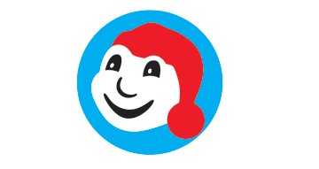
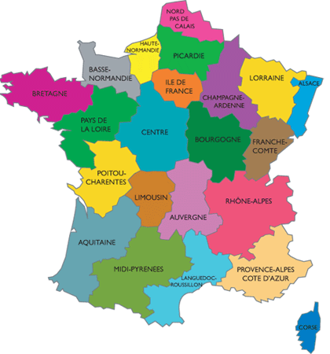
FRENCH AT PLECKGATE
YEAR 8 LEARNING JOURNEY
End of year listening, reading and writing assessments
Giving opinions in three tenses
Conjugating the perfect tense with IR and RE verbs
YEAR
9
Holidays
Culture week – Landmarks in France and French speaking countries
Negative sentences in three tenses
Using three tenses
Perfect tense activities
Conjugating the perfect tense with irregulars
C’était with opinions
Recall of avoir
Holidays
Negative sentences in the perfect tense
Conjugating the perfect tense with ER verbs
End of unit listening, reading and writing assessments
Perfect tense activities with irregular verbs
Holidays
Partitive articles
Ce sera with opinions
Conjugating in the near future
Recall of Aller in the present tense
Conjugating ER verbs in the present tense
Lead charity fundraising
Culture week – Carnaval de Quebec
Using Si
Asking a question with Qu’est-ce que
Conjugating irregular verbs in the present tense
Conjugating RE verbs in the present tense
Time recall
Comparative
End of unit listening, reading and writing assessments
Extracurricular activities
School
Conjugating IR verbs in the present tense
Describe lessons and lesson time
Question word
Culture week – Christmas in France
Culture week – Regions of France
Asking a question with Qu’est-ce que
Using opinion words
Two part structures with modals
My town
Two part structures with negative
Using faire + de
Two part structures with modals
Modal verbs
The following skills will be incorporated into all lessons:
listening, speaking, reading and writing (including translation).

