Slide 1
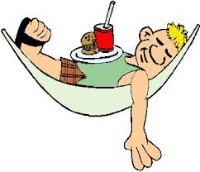
FRENCH AT PLECKGATE
YEAR 11 LEARNING JOURNEY
GCSE exams
GCSE Speaking exams (May)
A
Level
Revision and exam skills
Homelessness
How to protect the environment
Speaking exam preparation
Vices and unhealthy lifestyles
Social issues
Poverty
Volunteer work
Modal verbs
Using il faut + infinitive
January mock exams
Speaking exam preparation
Lead charity fundraising
Environment
Environmental problems
Conjugating verbs in the present and conditional tenses
Giving complex opinions
Direct object pronouns
Simple future tense
Future plans
Jobs and education post 16
Revision of jobs and gender
Part time jobs students currently have
Conditional tense
School rules
Il faut + infinitive
Giving complex opinions
Direct object pronouns
Revision of school subjects
School
Discussing daily routine
Reflexive verbs
Describing your school
Regular and irregular adjectival agreements
The following skills will be incorporated into all lessons:
listening, speaking, reading and writing (including translation).

